Slide 1
E-BUSINESS STRATEGY AND MODELS LECTURE 6
Economic of E-Business
DR. Collins C. Kachaka BSc, MSc, DBA (Cybersecurity),CCNA, CWNA, MCP, CEH, CHFI, ITIL, PCI DSS
Email : collinschi@gmail.com
© 2017

Slide 2
○ Digital economy (Internet economy/ New economy)
 Economy that is based in a large part on digital technologies, including digital communication networks, computers, software, and other related information technologies ( Turban et al., 2002)
 Components of digital ecosystems
○ Consumers
○ Sellers
○ Others
○ Intermediaries (e.g. search services, price comparison providers)  Support services (e.g. trust and security services)  Infrastructure companies (e.g. ISPs, hardware providers)  Content creators (e.g. news providers, other information providers)
○ Business partners (e.g. supply chain partners) etc.  Policy making bodies (Govt regulatory authorities)

Slide 3
DIGITAL ECONOMY: IMPORTANT CHARACTERISTICS
 Demand and supply
 Competition in the digital ecosystems  Cost curves of digital products  Cost reductions
 Role of critical mass  Pricing

Slide 4
DEMAND AND SUPPLY
○ Efficient market: Economists describe an efficient
market as one that clears or leaves no excess supply or demand
○ Limitations in traditional markets preventing efficient markets
 Difficulties in simultaneous participation of buyers and sellers due to geographical separation
 Lack of information and coordination  High transaction costs
○ Advantages in digital markets resulting in efficient markets
 No geographical constraints
 Readily available information and easy coordination facilities  Cheaper transaction costs

Slide 5
COMPETITION IN THE DIGITAL ECOSYSTEMS
○ The degree of competitiveness in an industry depends in part on how many suppliers are seeking the demand of consumers and the ease with which new businesses can enter and exit a particular market in the long run.
 Perfect competition: When the following assumptions exist
○ Several players (sellers) each with an insignificant market share  No entry barriers
○ Readily available information to buyers  Several identical products
○ All firms or sellers have equal access to resources (finance, technology etc.)
 Imperfect competition
○ When the above assumptions of perfect competition are dropped  Results in Monopoly, Duopoly, and Oligopoly
○ Features of perfect competition in digital economy
 Low barriers of entry in digital economy
○ Low overall setup costs
○ Several new e-shops opening everyday  Innovative business models
 Readily available information, speedy comparisons, and lower prices  Role of customisation/ personalisation/ customer service  Differentiation through product delivery, quality, and after sales service

Slide 6
COST CURVES OF DIGITAL PRODUCTS
○ In economics, a cost curve is a graph of the costs of production as a function of total quantity produced. In a free market economy, productively efficient firms use these curves to find the optimal point of production, where they make the most profits . (Answers.com, 2006)
○ Fundamentally different when compared to physical products and services
 High up-front costs
○ Research and development costs/ technology implementation costs
 Law of diminishing returns
○ In traditional industrial products
 Law of increasing returns  In digital economy
 Examples
○ e-Books (Net library) Vs traditional books (Prentice Hall)  iTunes (virtual store) Vs HMV (physical store)

Slide 7
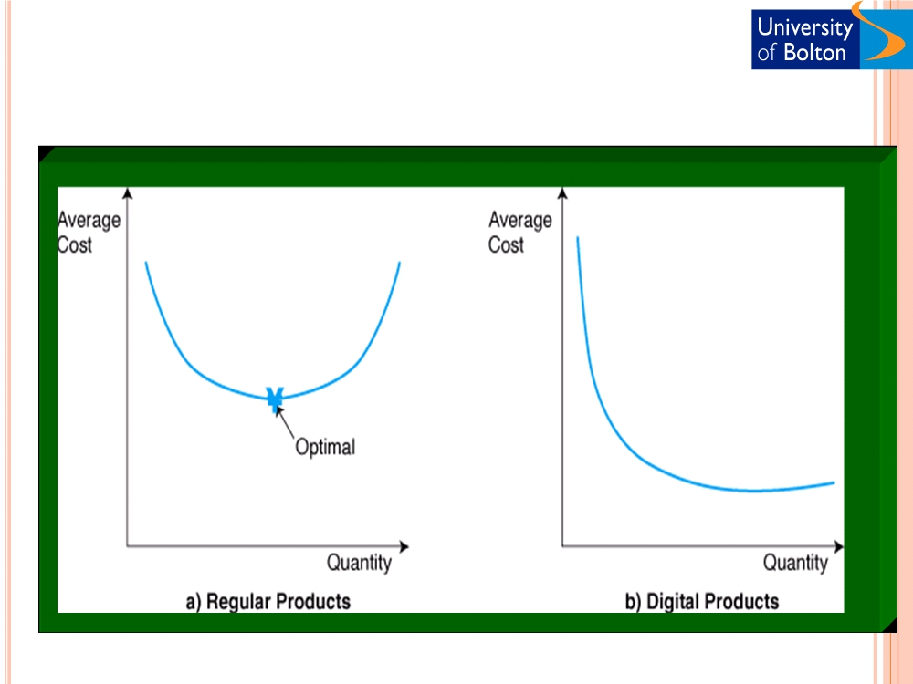
○
Cost curves or regular and digital products (Turban et al., 2002)

Slide 8
COST REDUCTION IN DIGITAL MARKETS
○ Production and distribution costs
 Business process reengineering
○ Reduction of administration and processing costs (online banking - e.g. FedEx)
 Electronic data interchange with suppliers
○ Reduction of inventory costs (JIT- E.g. Dell)  Intermediary costs
○ Cost reduction by elimination of intermediaries such as distributors or brokers (E.g. stock brokers)
○ Transaction costs
 Search and Information costs
○ 24 X7 X 365 Information about products and services  Bargaining and decision costs
○ Bargain online through electronic biddings
 Policing costs and Enforcement costs
○ Quality and contractual enforcement through trust providers and certifications

Slide 9
ROLE OF CRITICAL MASS
○ A minimum number of customers/users required for a product or service to make it financially viable. This number is referred to as the critical mass or critical minimum.
 If the demand is less than the critical mass, the product/service service will not be offered commercially, regardless of its technical capability.
 Critical mass plays a more significant role in digital markets when compared to traditional markets
○ Winner takes it all
 Resulting in market monopoly
○ Microsoft Windows in PC operating systems  Google in search engine service
○ Locking customers into a product or service
 Bundling products and services
○ Paypal in eBay
 Offering related products
○ Comprehensive services on yahoo (email, chat, news etc)
○ Exists in traditional marketplace but rampant in digital economy
 Tesco and Asda-Walmart in traditional markets
 Microsoft and yahoo in digital markets
○ Free offerings to build critical mass customer base
 Netscape and Internet explorer
 Real player and Media player

Slide 10
Winner
Market Share
Loser
Time
(Chen, 2003)

Slide 11
PRICING
○ Pricing determines sales volume, market share and profitability. Pricing is generally based on:
 Customers product valuation
○ How much customer is willing to pay
○ Low price is not always the determining factor  Perceived benefits
○ Different customers perceive different benefits from a product
 Target customers
○ Early adopters, Majority, and Laggards (Rogers, 1962)
○ Price discrimination ability
 Ability to charge different prices to different customers  Types of price discrimination
○ Third degree: based on group identification (E.g. Student discounts)  Second degree: based on product attributes (E.g. features/ delivery schedules)
○ First degree or perfect: based on each buyer‟s willingness to pay (E.g. Auctions)
○ Pricing the digital products
 Different and complex when compared to physical product pricing
○ iTunes Vs record companies (55p/ song on iTunes)

Slide 12
DIGITAL ECONOMY : WINNERS AND LOSERS
○ Winners
 E-Shops (iTunes, Amazon)
 Internet Service Providers (NTL, BT)
 Search engine service providers (Google, Kelkoo)  Diversified portal services (Yahoo, MSN)  E-Business technology providers
○ Software (SAP, Microsoft, Oracle, Sun )  Hardware (HP, Dell)
 Trust and security service providers (Pay pal, Norton)  Large click and mortar retailers (Tesco, John Lewis)  and……………CONSUMERS
○ Losers
 Wholesalers, distributors, and retailers
○ Book distributors such as Blackwell and Waterstone
 Brokers
○ Airline ticketing brokers
 Sales professionals
○ Insurance, Mutual fund and other financial services salespeople  Utilities (Telecom, Gas, etc.)

Slide 13
DIGITAL ECONOMY: SOME STRATEGIES
○ Innovative business models
 Value chain integration (Dell, FedEx)
○ Digitisation of products and services
 Digital industry reports (Gartner, IDC)  Digital music (iTunes)
○ Price discrimination
 Online car insurance (Churchill, AA, BSM)  Mobile phone offers and tariffs (Orange)
○ Building critical mass customer base
 Windows PC operating system (Microsoft)  Email and other portal services (Yahoo)
○ E-marketing
 Affiliate marketing on other portals (eBay)
○ Customisation/ personalisation
 Personalised product offer (Amazon)

Slide 14
FURTHER WORK & DISCUSSION
 Group 1: Explore detrimental factors of market efficiency in your organisation‟s industry sector and describe how technologies can help overcome them
 Group 2: Explore how digital economy can help your organisation reduce costs in various areas
 Group 3: Select a case organisation and identify the opportunities for online/offline price discrimination within the organisation‟s customer base
 Group 4: Identify the products and services that can be digitised in your organisation
 Group 5: Select a case company and identify opportunities for building critical mass of customers to gain competitive advantage
 Group 6: Identify the business contexts where the policy issues can affect your organisation‟s operations on the e-business landscape.
○ Give special emphasis on customer information issues
○ References
 Chen, S. (2001) “Strategic Management of E-business”, Chapter twelve, John Wiley & Sons.

