Slide 1


E-BUSINESS STRATEGY AND MODELS
LECTURE 3
E-Business Strategy initiation
DR. Collins C. Kachaka BSc, MSc, DBA (Cybersecurity), CCNA, CWNA, MCP, CEH, CHFI, ITIL, PCI DSS
Email : collinschi@gmail.com
© 2017

Slide 2

STRATEGY
○ A broad-based formula for how a business is going to compete,
what its goals should be, and what plans and policies will be
needed to carry out those goals (Porter, 1980).
○ Strategy defines the future direction and actions of an
organisation or part of an organisation (Chaffey , 2009).
○ Strategies happen everywhere…all the time
 Personal - Organisational - Political - Economical - Social
○ An organisation‟s strategy addresses certain fundamental
questions about its current position and future directions (Jelassi
and Enders, 2005).
○ What is the long-term direction of our organisation?
○ What is the overall plan for deploying our organisational resources?
○ What trade-offs are necessary?
○ What is our unique positioning vis-à-vis competitors?
○ How do we achieve sustainable competitive advantage?
○ The formulation and execution of a vision of how a new or existing
company intends to do business electronically (Turban et al., 2006).
Strategy is determining of what a company should do
and also making though decisions about what not to
do.

Slide 3
ORGANISATION STRATEGY
In an organisation there are different levels of strategy (Johnson &
Scholes , 2006).
 Corporate strategy
○ Concerns with overall purpose and scope of the organisation.
 Business unit strategy
○ Provides ways of competing successfully in a market.
 Operational strategy
○ Concern with corporate and business unit strategies.
 Functional or process strategy
○ Describes how corporate and business unit strategies will be operated
in different functional areas.
○ Marketing
○ Supply chain management
○ Human resource
○ Finance
○ Information systems

Slide 4
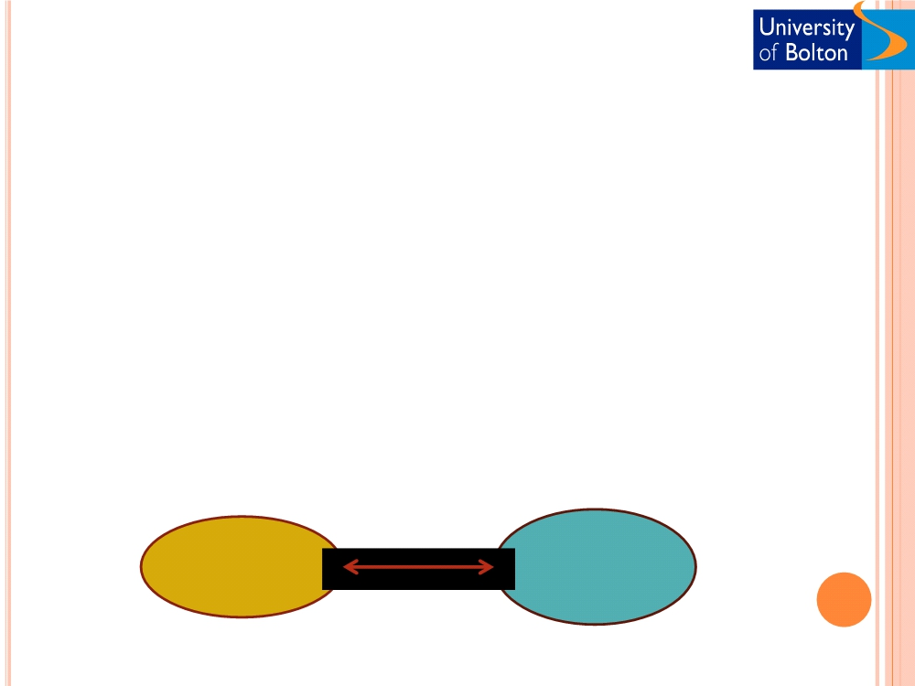
E-BUSINESS STRATEGY
○ E-business strategy is definition of the approach by which applications
of internal and external electronic communications can support and
influence corporate strategy. (Chaffey , 2009)
○ Lack of e-business strategy may result in:
 Missed opportunities
 Lack of process support
 Lack of integration and cooperation in different parts of the organisation
 Resource wastage
To avoid the above problems
○ E-business strategy should be based on corporate objectives
○ Corporate objectives should be based on new opportunities and threats
related to e-network adoption
Corporate
E-business
strategy
strategy

Slide 5
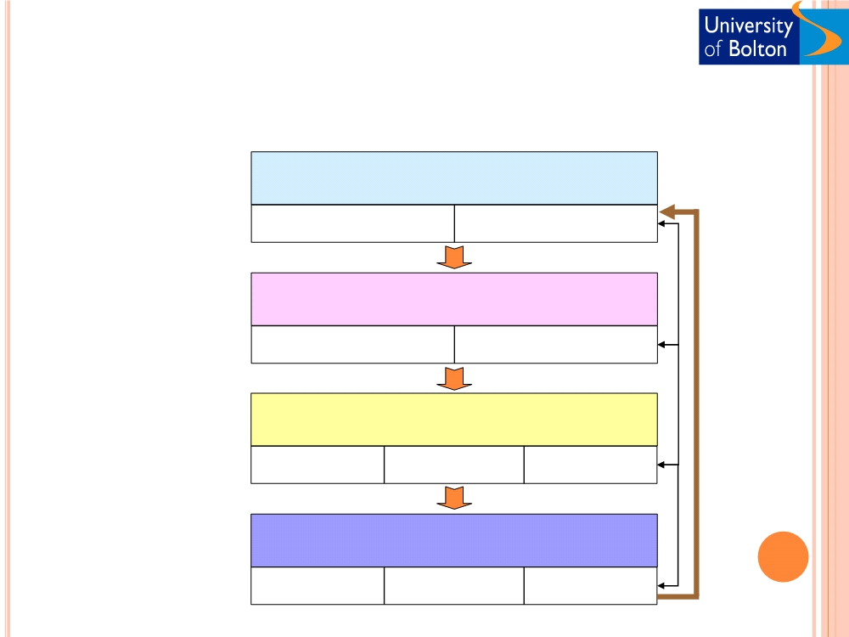
STRATEGY PROCESS MODEL
(CHAFFEY 2002)
Strategic Analysis
Framework that
gives
External Environment
Internal Resources
a logical sequence to
follow to ensure
Inclusion of all key
activities of strategy
development
Strategic Objectives
Vision, Mission Objectives
Monitoring,
evaluation,
and response
Strategic Definition
Generation Evaluation Selection
Strategic Implementation
Planning Execution Control

Slide 6
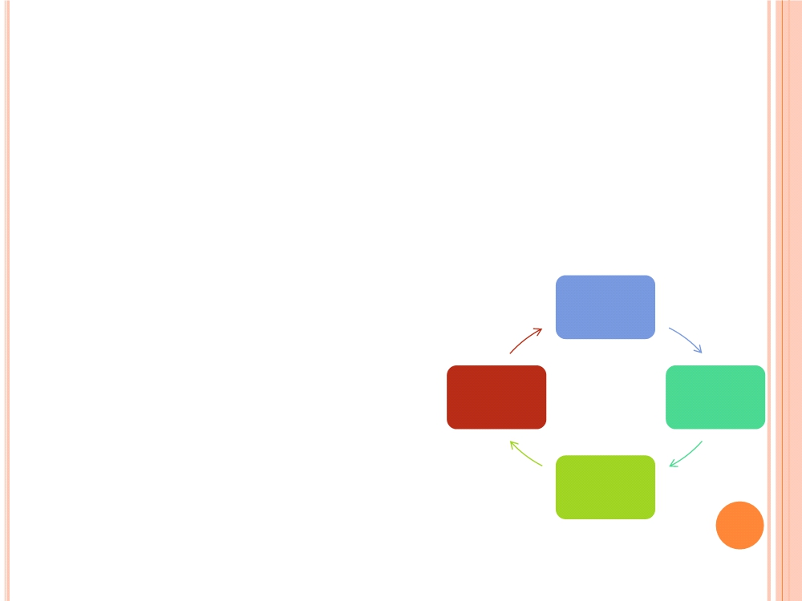
STRATEGY PLANNING PROCESS
○ Business plan
○ A written document that identifies the company‘s goals and outlines how the
company intends to achieve these goals
○ A business plan results from strategy setting
○ Serves as a comprehensive document for both internal and external
organisational stakeholders
○ To get funding from venture capitalist or a financial institution
○ To acquire other resources such as equipment from suppliers.
○ To establish collaborations with other organisations
Strategy
initiation
○ Strategic planning process
forces organisational management Strategy
Strategy
assessment
formulation
to assess the current position of
the company , where it should be,
and how to get from here to there.
Strategy
implementati
on
(Turban et al, 2006)

Slide 7
STRATEGY DEVELOPMENT AND
IMPLEMENTATION TOOLS
○ Strategy initiation
 Porters five forces model
 Value Chain Analysis
 McFarlan‘s Strategic Grid
 SWOT analysis
 PEST analysis
 Gap Analysis
○ Strategy formulation
 BCG growth-share matrix
 Return on Investment (ROI)
 GE Multifactor business portfolio matrix
 Scenario planning
 Road mapping
○ Strategy implementation
 Project management
 Business Process Reengineering (BPR)
 Piloting
○ Strategy assessment
 Balanced scorecard
 Web analytics
 ROI
( Turban et al., 2006 )

Slide 8
E-BUSINESS STRATEGY INITIATION
In this phase the organisation examines itself and its environment by:
 Setting the organisation‘s missions and goals
 Assessing environmental factors impacting the business
 Conducting a competitor analysis
The outcome from this phase should include:
○ Company analysis
 Vision, purpose, value proposition, capabilities, constrains, strengths, and weaknesses
of the company.
○ Core competencies
 Unique combination of the resources and experiences of the company.
○ Forecasts
 Identifying business, technological, political, economic, and other relevant trends that
are/will affect the business.
○ Competitors analysis
 Scan the business environment to collect relevant information about competitors.

Slide 9
TOOLS FOR INITIATION ANALYSIS
○ Porter and Millar‟s five forces model
○ Value chain analysis
○ McFarlan‟s strategic grid
○ SWOT analysis
○ PEST analysis
○ GAP analysis

Slide 10
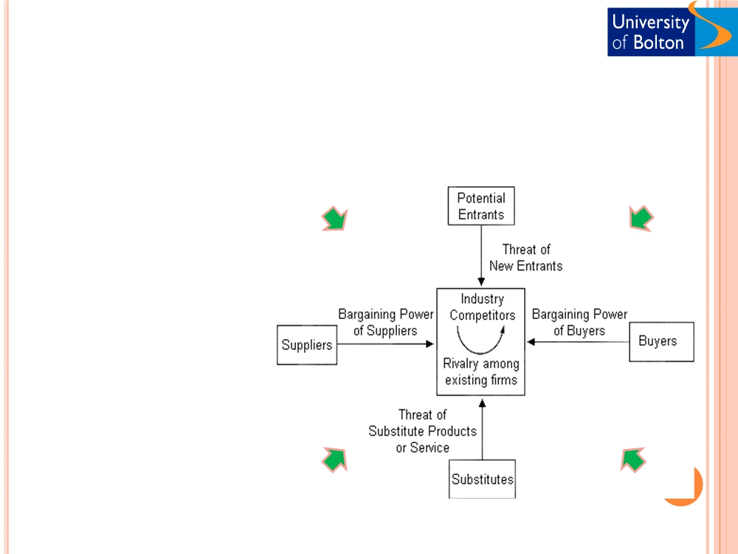
Porter’s five forces model (Porter, 1985)
Porter‟s Competitive
Strategies
o Overall cost leadership
o Differentiation
EB
EB
o Focus or niche
o Stuck in the middle
o Strategic Alliances
EB
EB

Slide 11
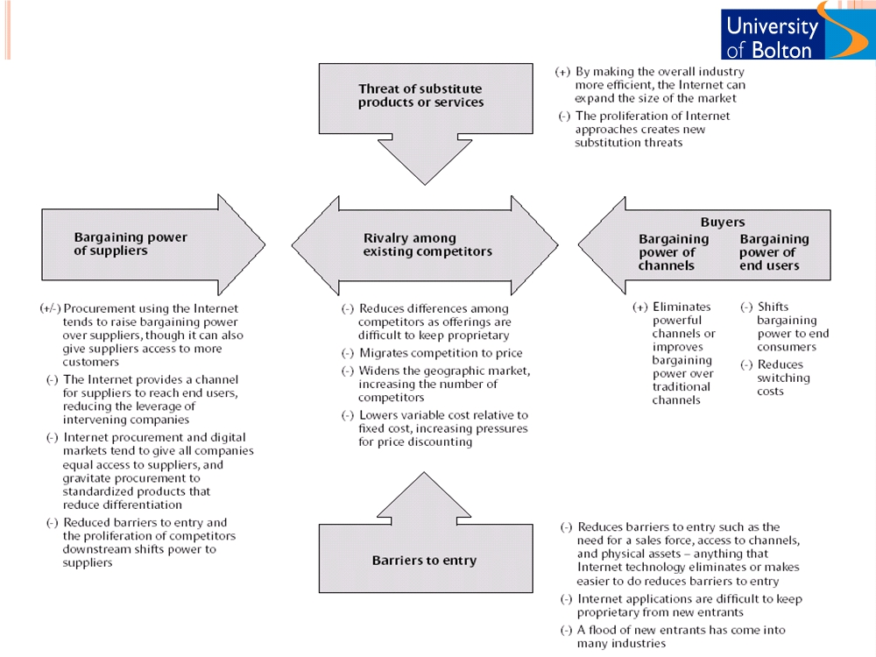
IMPACT OF THE INTERNET ON THE FIVE COMPLETIVE FORCES

Slide 12
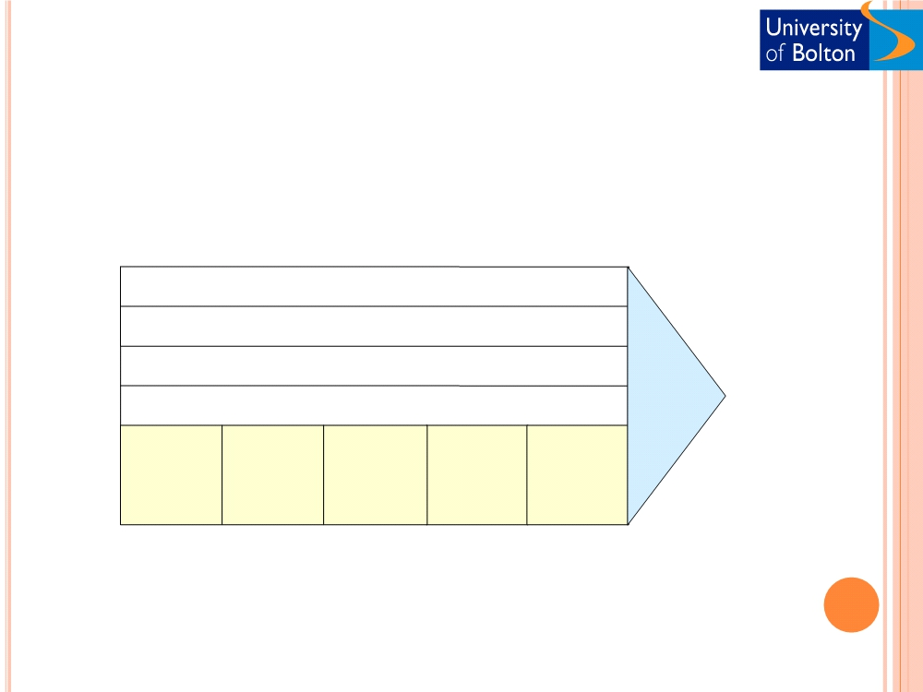
VALUE CHAIN ANALYSIS
Corporate administration and infrastructure
Human resources management
Product technology/development
Procurement
Margin
Inbound Outbound Sales and
logistics
Operations
logistics
Services
marketing
(Porter, 1980)

Slide 13
IMPACT OF ICT ON VALUE CHAIN
○ Assess the information intensity
○ Determine the role of ICT in the industry
structure
○ Identify opportunities for competitive
advantage
○ Investigate new business opportunities
○ Develop plans to take advantage of ICT

Slide 14

MCFARLAN‟S STRATEGIC GRID -
APPLICATION PORTFOLIO MODEL
• Across industries for analysing
strategic importance that
particular industries attach to
IS
Turnaround
Strategic
• Within a company, different
departments can be classified
and goals set in relation to the
future planned importance of IS
Support
Factory
• Within an industry can be
plotted according to the relative
significance they attach to IS
Low
High
(Hirscheim et al (1988), Ward & Griffiths,
1996)
Strategic importance of current IS

Slide 15

MCFARLAN‟S STRATEGIC GRID
○ Summary applications of a portfolio analysis for an
example B2B
High potential
(Beware)
Strategic (Attack)
• Procurement system
• Electronic catalogue
• Stock control system
• E-commerce system
• distribution systems
• Customer intelligence
and CRM systems
Support (Safe)
Key operational
(Explore)
• HR systems
• Production line systems
• Finance system
Low
High
Strategic importance of current IS
(Chaffey, 2009)

Slide 16

SOWT ANALYSIS
○ Analyse external opportunities and threats and relate
them to internal strengths and weaknesses.
○ The SWOTs are used as inputs to the creative generation
of possible strategies, by asking and answering the
following four questions many times:
1. How can we Use each Strength?
2. How can we Stop each Weakness?
3. How can we Exploit each Opportunity?
4. How can we Defend against each
Threat?

Slide 17
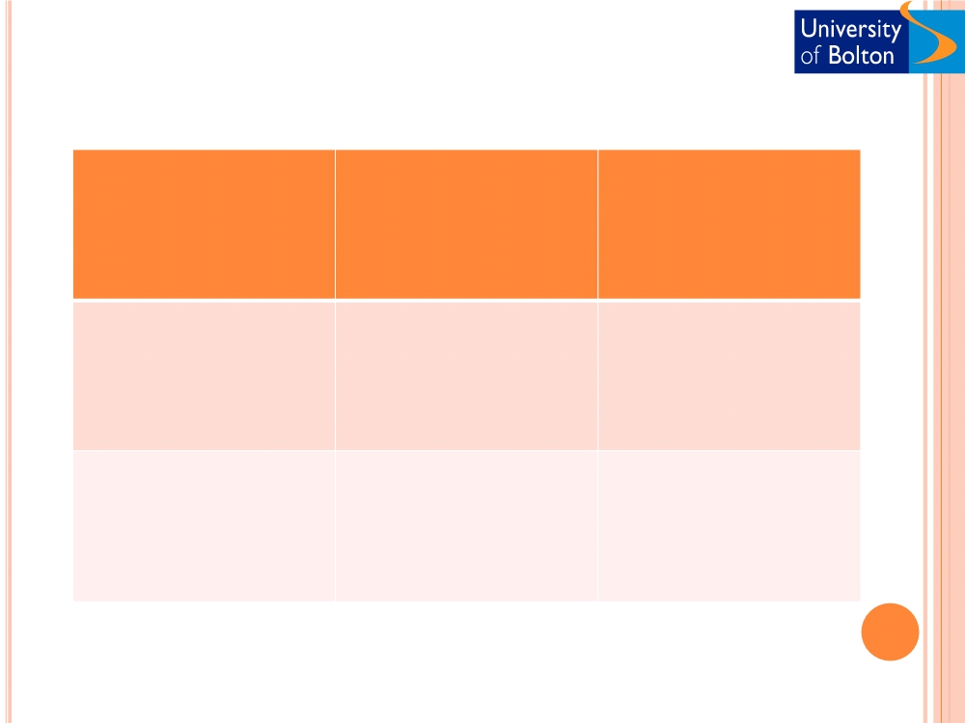
SOWT ANALYSIS
Example: SOWT analysis
Strengths - S
Weakness - W
1. Existing brand
1. Brand perception
The organisation
2. Existing customer
2. Intermediary use
base
3. Technology/ skills
3. Existing distribution
4. Cross- channel
support
Opportunities - O
SO strategies WO strategies
1. Cross- selling
Leverage strengthens to Counter weaknesses
2. New markets
maximise opportunities through exploiting
3. New services
opportunities
4. Alliances/co-branding
Threats - T
ST strategies WT strategies
1. Customer choice
Leverage strengths to Counter weakness and
minimise threats threats
2. New entrants
3. New competitive
products
4. Channel conflict
(Chaffey, 2009)

Slide 18
PEST ANALYSIS
Assess political, environmental, socio-cultural, and technological (PEST) factors
for their impact on the organisation
○ Political/legal
○ Legislation, law, foreign trade, policies, politics
○ Economical
○ Interest rate, money supply, inflation, employment
○ Socio-cultural
○ Population demographics, income distribution, level of education,
work attitudes (work from home), cost of access, value proposition,
ease of use, security, fear of unknown.
○ Technological
○ R&D, speed of development/transfer

Slide 19
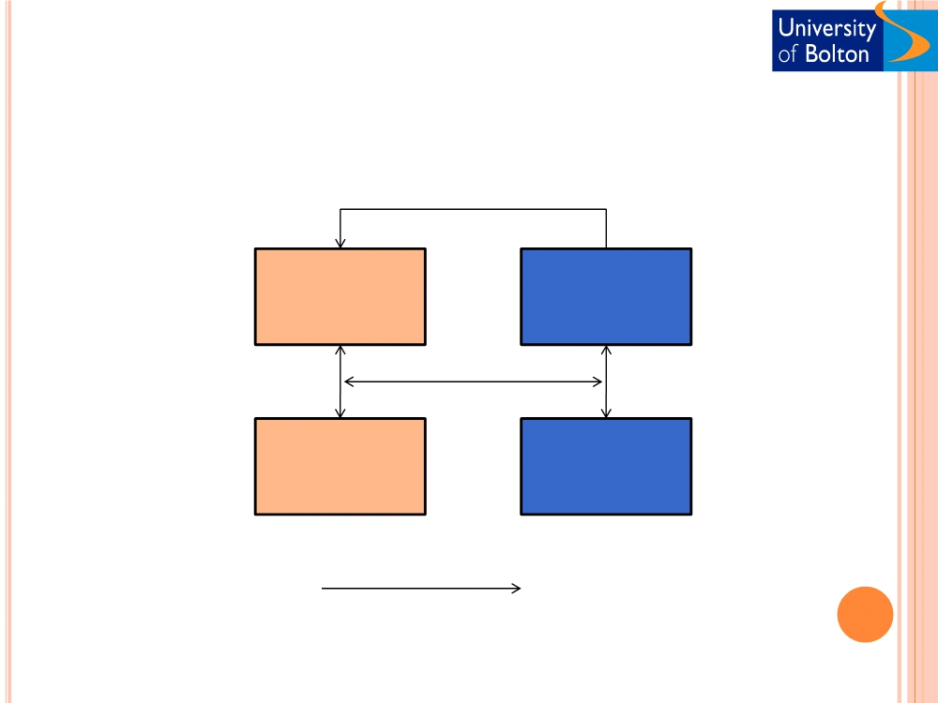
GAP ANALYSIS
Current skills, knowledge, competencies, capabilities, and future
requirements.
What firm
must know
What firm
must do
Knowledge &
resources gap
Strategic
gap
What firm
knows
What firm
can do
What knowledge and resources
is required to achieve;
What are we trying to accomplish?
How do we gain competitive edge?
How do we deliver results?
How do we manage change?

Slide 20
E-BUSINESS STRATEGY INITIATION AND
ISSUES - I
○ First mover Vs Follower
○ Advantages/ opportunities of being a first mover
 First and lasting impression on customers
 Establish strong brand recognition
○ Risks of being a first mover
 High cost of e-business initiatives
 Making mistakes that followers can avoid (Online grocers at the initial .com boom)
 Too early to the market that is not ready (Home banking systems in 1990‟s)
○ Success factors for the first mover (Rangan and Adner, 2001)
 Size of the opportunity
○ The company and the market opportunity should be big enough for each other
 Nature of the product/ service
○ Tougher entry barriers for the followers
 The probability of first mover becoming the best in the market
○ Competitive advantage
○ Examples
 Successful first movers
○ eBay, Yahoo (Groups, Directories, etc.), Apple computer
 First movers who lost to the late comers
○ Sony (digital music players) lost to Apple iPod…………………Citibank (ATMs) lost to
Cirrus……….………..…Intel microchip won over its earlier counterparts

Slide 21

E-BUSINESS STRATEGY INITIATION AND
ISSUES - II
○ Born-on-the-net Vs Move-to-the-net
Both type of organisations will have a set of assets and liabilities on the strategy balance sheet
Born-on-the-net
Move-to-the-net
Assets
• Agile and flexible organisation
• Established customer base
• Risk taking appetite
• Previous knowledge of customers
• Hunger for success
• Previous knowledge of environment
• Entrepreneurial and young management
• Established brand, loyalty, etc.
• Flat organisational structures
• Existing organisational resources
• New information systems
• Rapid implementation capability
Liabilities
• Zero customer knowledge on the day one
• High level of competition from existing online player
• Lack of brand and reputation
•Old and lethargic organisational infrastructure
• Necessity to build everything from scratch
• Legacy systems and processes
• Dependence on outside sources for capital
• Rigid organisational structures
• Lack of expertise on logistics, channels,
• Excessive dependence on past success, products and
marketing etc.
services.

Slide 22
E-BUSINESS STRATEGY INITIATION AND
ISSUES - III
○ Determining scope (for growing the business)
 Gaining new set of customers
○ Increasing the size or scale of the business
○ Offering new products and services
○ Establishing separate online company
 Large anticipated volume for e-business
 Traditional business becoming a constraint to the e-business
 Independence from legacy systems
 Flexibility towards future collaborations
 Examples
○ Ocado (Waitrose)
○ First direct ( A division of HSBC)
○ Establishing separate online brand
 First movers and existing firms with a weak/online irrelevant
brand
 Established global firms may push their traditional brands
online
 Examples
○ Bell.co.uk (Admiral)
○ Cahoot (Abbey National)

Slide 23
ACTIVITY AND DISCUSSION
❑ Initiate an e-business strategy (a case)
using the following approaches and discuss
the issues involved.
❑ Porters five forces model
- Group 6
❑ Value Chain Analysis
- Group 5
❑ McFarlan‟s Strategic Grid
- Group 4
❑ SWOT analysis
- Group 3
❑ PEST analysis
- Group 2
❑ Gap Analysis
- Group 1

