Slide 1
GSB
E-BUSINESS STRATEGY AND MODELS LECTURE 1
E-BUSINESS STRATEGY AND MODELS LECTURE 1
Introduction to E-business &
E-Business Introduction
role in the current business environment
DR. Collins C. Kachaka BSc, MSc, DBA (cybersecurity), CCNA, CWNA, MCP, CEH, CHFI, ITIL, PCI DSS
DR. Collins C. Kachaka BSc, MSc, DBA (cybersecurity); CCNA, CWNA, MCP, CEH, CHFI, ITIL
Email : collinschi@gmail.com
© 2013

Slide 2
○ e-Business definitions
○ Arrival of new economy
○ e-Business and ecommerce
○ e-Business strategies and models
○ Role of e-Business in current environment
○ Business pressures and organisational responses  Advantages of e-Business
○ Key features of internet for business

Slide 3
E-BUSINESS - DEFINITIONS
○
“Conducting business on the Internet, not only buying and selling, but also serving customers and collaborating with business partners”.
(whatis.com)
○
“E-business is any process that a business organization conducts over computer-mediated network channels. Business organizations include any for-profit, governmental, or non-profit entity. Examples of these processes are on-line purchasing, on-line sales, on-line logistics,
customer support, employee training and recruiting, and vendor-
managed inventory, production design and control.” (US Census
bureau)
○
“E-commerce is an emerging concept that describes the process of buying, selling, or exchanging products, services and information via computer networks, including the Internet …………………..E-business
refers to a broader definition of E-commerce, not just the buying and
selling of goods and services, but also servicing customers, collaborating with business partners, and conducting electronic transactions within an organization.” (Turban et al., 2002)

Slide 4
ARRIVAL OF NEW ECONOMY- 1: CHARACTERISTICS
○ Knowledge economy
 Resource shift, knowledge work, information usage etc.
○ Globalisation
 Borderlessness, free markets, customer base etc.
○ Product life cycles
 Product obsolescence
○ Competition
 Global competition, cost reduction, plane field etc.
○ Innovation
 Continuous innovation

Slide 5
ARRIVAL OF NEW ECONOMY -2: SOME VIEWS
○
―For countries in the vanguard of the world economy, the balance between knowledge and resources has shifted so far towards the former that knowledge has become perhaps the most important factor determining the standard of living today‘s most technologically advanced economies are truly knowledge
based‖ - World Bank (1998)
○
―E-Business is all about time cycle, speed, globalisation, enhanced productivity,
reaching new customers and sharing knowledge across institutions for
competitive advantage‖ - Lou Gerstner (CEO, IBM)
○
―future knowledge-based organisations will have half the number of management
layers found in businesses today - and the number of managers will be cut by
two thirds‖ - Drucker (1998)
○
―The rate of obsolescence in IT industry is around 2% a month, making
innovation an organisational necessity‖ - (Premji, 2003)
○
―This reinvention starts with recognition of some fundamental truths. Current
levels of market demand are the result of long-term structural changes in buyer‘s
requirements rather than simple cyclical trends. High price, long lead time,
amorphous objectives and unquantifiable return style projects were wonderful for
the industry — while they lasted — but they are now, and will remain, history‖ -
Pring (2003).

Slide 6
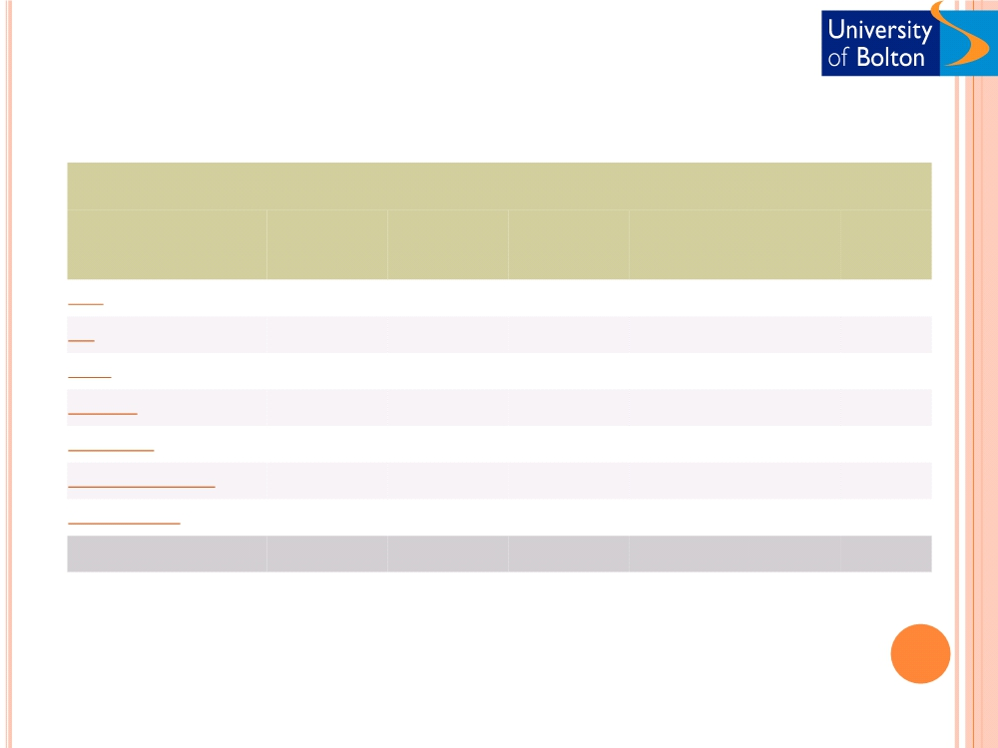
WORLD INTERNET USAGE AND POPULATION STATISTICS
World Regions
Population Internet Users Internet Users
Penetration Growth Users %
( 2010 Est.) Dec. 31, 2000 Latest Data
(% Population) 2000-2010 of Table
Africa
1,013,779,050 4,514,400 110,931,700
10.9 % 2,357.3 % 5.6 %
Asia
3,834,792,852 114,304,000 825,094,396
21.5 % 621.8 % 42.0 %
Europe
813,319,511 105,096,093 475,069,448
58.4 % 352.0 % 24.2 %
Middle East
212,336,924 3,284,800 63,240,946
29.8 % 1,825.3 % 3.2 %
North America
344,124,450 108,096,800 266,224,500
77.4 % 146.3 % 13.5 %
Latin America/Caribbean
592,556,972 18,068,919 204,689,836
34.5 % 1,032.8 % 10.4 %
Oceania / Australia
34,700,201 7,620,480 21,263,990
61.3 % 179.0 % 1.1 %
WORLD TOTAL
6,845,609,960 360,985,492 1,966,514,816
28.7 % 444.8 % 100.0 %
www.InternetWorldStats.com

Slide 7
Online Activities
Scope
Percentage
❑ E-mail
92
❑ Surf the web for fun
84
❑ Visit an entertainment site  Look for info on hobbies
83
69
❑ Get news
68
❑ Play or download games  Research
66
66
❑ Listen to music online  Visit a chat room
59
55
❑ Check sports scores  Employment
47
26
❑ Games
26
❑ Create a web page  Car search
24
21
www.InternetWorldStats.com

Slide 8
When adults last used the Internet, by sex and age group, 2008 to 2010
Within the last 3 months
More than 3 months
Never used
2008
2009
2010
2008
2009
2010
2008
2009
2010
Per cent
Men
75
80
79
4
3
5
20
17
16
Women
66
72
75
5
4
4
29
24
21
All
71
76
77
5
4
4
25
21
18
16-24
93
96
97
5
3
2
1
3
1
25-44
87
92
93
5
3
3
8
5
4
45-54
78
81
84
4
3
4
17
16
11
55-64
63
72
72
4
4
6
33
24
22
65+
26
30
32
5
5
7
70
64
60
Base: UK adults

Slide 9
E-BUSINESS AND E-COMMERCE - 1
○ Ecommerce

―the process of buying, selling, or exchanging products, services, and information via computer networks, including the internet‖.
○ E-Business
 Not just buying and selling of goods and services, but also servicing customers, collaborating with
business partners, and conducting electronic
transactions within an organisation
(Turban et al., 2002)

Slide 10
e-Business and eCommerce - 2
E-Business
E-Commerce
Customer service
Buying and selling Collaboration
Information exchange

Slide 11
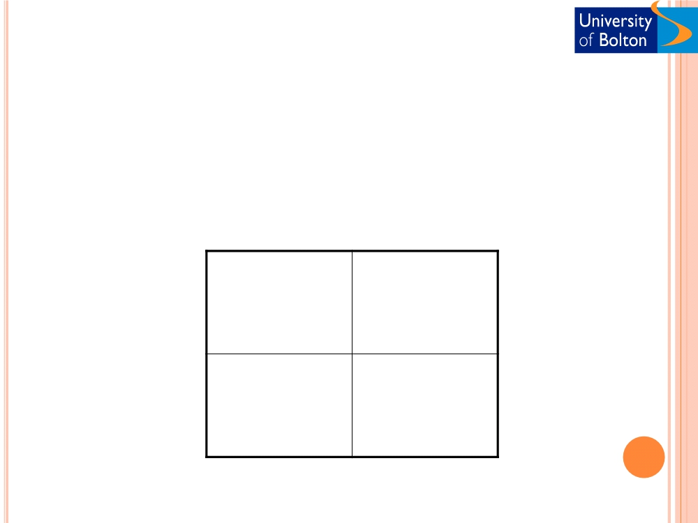
Types of e-Business
 Core classification (Chen, 2001)
Business
Consumer
Business
B2B
B2C
www.covisent.com
www.tesco.co.uk
Consumer
C2B
C2C
www.priceline.com
www.ebay.com

Slide 12
○ Business-to-business (B2B)

Slide 14
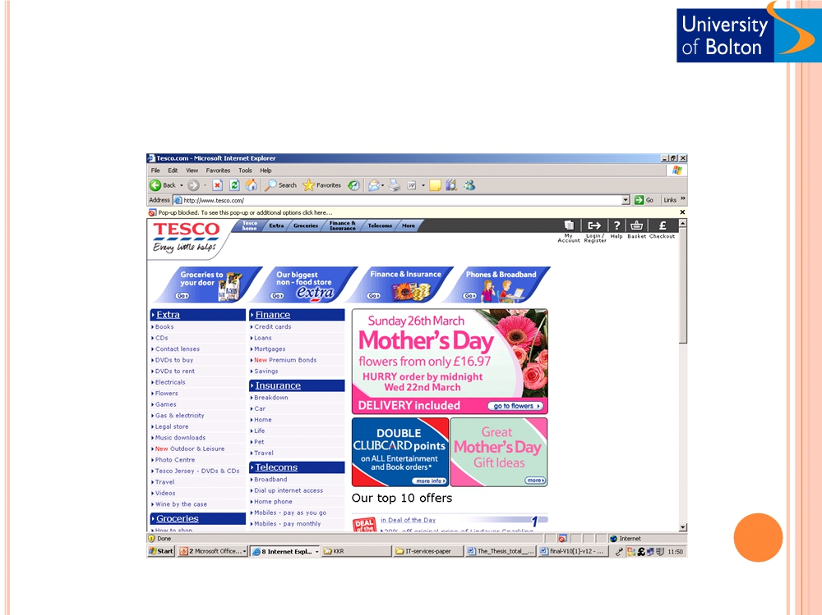
○ Business-to-consumer (B2C)

Slide 15
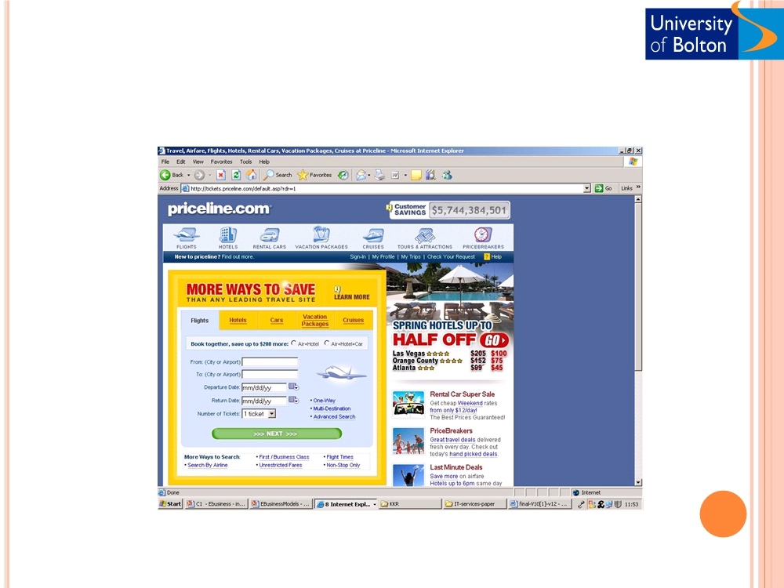
○ Consumer-to-business (C2B)

Slide 16
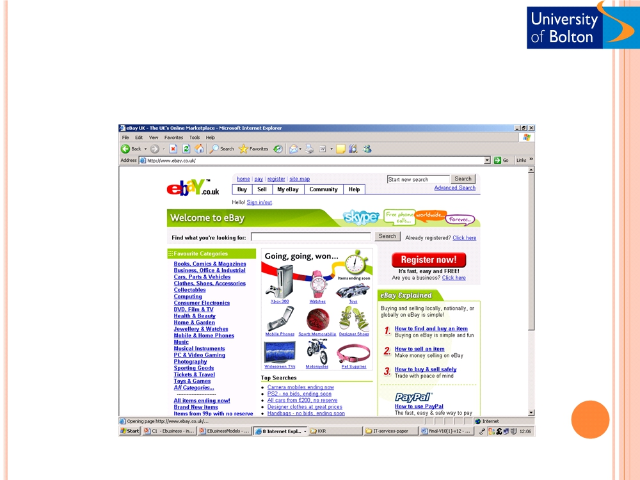
○ Consumer-to-consumer (C2C)

Slide 17
E-BUSINESS STRATEGY
○ “A strategy is a comprehensive plan guiding resource allocation to achieve long-term
organisational goals” - (Schermerhorn, 2005)  Define objectives
 Assess external and internal environments  Identify gaps
 Develop strategy
 Implement strategy
 Evaluate strategy
○ Characteristics of e-business strategies
 Virtual transactions
 Unstable market environments
 Customer issues (loyalty, price sensitivity

Slide 18
E-BUSINESS MODEL
○ Business model
 ―a method of doing business by which a company can generate revenue to sustain itself‖ (Turban et al., 2002)
 Examples
○ Confused.com  Ebay.com
: Financial brokerage : Online auctioning : Internet banking
○ Firstdirect.com  Ocado.com
: Collaborative internet grocer : ???
○ Other examples

Slide 19
BUSINESS ENVIRONMENT
○ Business Environment is a set of internal and external factors that influence the way that the
business is performed.
○ Environment influence the way that an organisation is operating.
○ Business operation requires strategy development.
○ Business strategy influenced by environment.
Environment
Business Strategy operation development

Slide 20
BUSINESS ENVIRONMENT
 Internal
○ Usually within the control of business
○ 5 Ms: man, material, machinery, money, and management
 External
○ Beyond the control of the business  Micro- environment
 The environment which is close to business and affects its capacity to work
○ Macro- environment
 It includes factors that create opportunities and threats to business units.

Slide 21
EXTERNAL ENVIRONMENT
○ Micro-environment
 Customers
Macro-
○ Needs and requirements  Manufacturers
environment
○ Wholesalers  Retailers
Micro-
environment
○ Government  End-user
 Competitors
Organisation
○ Product and services  Intermediaries
○ Product and services  Middleman
○ Marketing agencies  Financial intermediaries  Physical intermediaries  Suppliers
○ Product and services Public
○ Any group that have interest in business. (media or local public)

Slide 22
MACRO-ENVIRONMET
○ Macro-environment factors (PEST or SLEPT factors)
○ Social
○ Consumers internet usage, cultural factors, moral constraints
○ Legal
○ Online selling methods determined by government
○ Economical
○ Determine spending patterns in different regions
○ Political
○ Determine the future rules of internet adoption (national government and transnational organisations
○ Technological
○ Changes in technology offer new opportunities to the way products can be marketed

Slide 23
MAJOR BUSINESS PRESSURES (TURBAN, 2002)
 Market
○ Global
○ Competition
○ Changing workforce  Powerful consumers
 Technology
○ Innovations  Obsolescence
○ Information overload  Electronic commerce
 Society
○ Social responsibility
○ Government regulations  Deregulations
○ Shrinking budgets/ Subsidies  Ethics

Slide 24
ROLE OF E-BUSINESS
 Increase sale and purchasing opportunities and decrease cost
○ Access global markets
○ New markets, customers, virtual community
○ Business processes improvement
○ Reengineering, supply chain optimisation, cost reduction, employee training, and finance management, etc
○ Collaborations (product development etc.)
○ Collaborative product/service offering and Innovation

Slide 25
ORGANISATIONAL RESPONSES - I
(TURBAN, 2008)
○ Strategic systems
 Improve strategic advantage in industry
○ FedEx: Consignment tracking systems
○ Dell: Online customisation/configuration of PC‘s  Sainsbury's: Supply chain management
○ Agile systems
○ Increase flexibility and change adaptability  RFID, SCM
○ Electronic market
 Cooperation of different companies with the same products
○ Use private and public e-market to increase efficiency and effectiveness  Emarket, VDMA e-market
○ Business alliances
 Alliances with other organisations even with competitors
○ Oracle and Sun
○ Covisint: General Motors, Ford, Peugeot etc.
○ Knowledge Management
 Increase productivity, agility and competitiveness

Slide 26
ORGANISATIONAL RESPONSES - II (TURBAN, 2002)
○ Business Process Reengineering
 Major innovations in organisation‘s structure and business operations
○ Technological (ERP, SCM, KM, CRM, etc)
○ Human
○ Organisational
○ Continuous improvement
 Continuous improvement of productivity, quality, and customer service (yahoo, ebay, apple)
○ Customer relationship management
○ Customer selection, loyalty and service
○ Identify customers with the greatest profit potential  Data mining systems
○ Supply chain improvement
○ Reduce inventory
○ Cycle time reduction
 Speed up the operation and reduce time to market
○ Mass customisation
○ Build to order system  Dell
○ Product and service quality
○ Detect quality problems and minimise them
○ Research and development
○ Improve quality, efficiency, products and services

Slide 27
KEY FEATURES OF INTERNET FOR BUSINESS
 Multimedia
 Ubiquity
○ Information provision, education, and entertainment
○ Rapid spread of internet access
 Interactivity
 Availability
○ Customer interactivity and virtual relations
○ Any time
 One-to-One
 Global
○ One-to-One Customer relationship management
○ Borderlessness
 Local
 Network effects and network externalities
○ Explore and establish local business relationships
○ Virtual networks, Third party market places etc.
 Digitisation
○ Revolutionary changes in telecom services, product offer, and economics
 Integration
○ Combined information (eg. 360 view of customer)
(Timmers, 1999)

Slide 28
BENEFITS OF E-BUSINESS
 To Consumers
○ Lower/ competitive prices  24X7X365 shopping
○ Wider Choice and comparisons
○ Instant access to detailed product information  Selling unwanted products (e-auctions)
○ Reduce the waiting time for delivery (music, software, video files, etc)
 To Organisations
○ Tapping wider markets (national and global)
○ Cost reduction (production, distribution, marketing etc.)  Improved service (faster delivery, time to market etc.)  Low entry cost (Cisco systems)
○ Fast return on investments (ROI)  Access to remote area
 To Society
○ Environmental benefits  Less travel
○ Improved affordability
○ Access to information/ knowledge/education  Work from home (balance)
○ Accessible to remote areas

Slide 29
DISADVANTAGES OF E-BUSINESS
○ Can not be applied to all business sectors
○ Technological issues
 Access
 Integration
○ Cultural issues
 Customers choice  Lack of trust
 Resistant to change
○ Return on investment
 Difficult to quantify cost and benefit  Employee recruitment and retention
(Schneider, 2009)

Slide 30
ACTIVITIES AND DISCUSSIONS
○ Identify 3 examples each of B2B, B2C, C2B and C2C types and their business environment
○ Identify an e-Business model in airline industry, property search, insurance industry, retail sales,
○ Discuss the competitiveness of the business model in a recessionary period
○ Which features of an e-business make is a source of competitive advantage or its Achilles heel ?

