Slide 1
E-BUSINESS STRATEGY AND MODELS LECTURE 5
E-Business Architecture and technology
DR. Collins C. Kachaka BSc, MSc, DBA (cybersecurity), CCNA, CWNA, MCP, CEH, CHFI, ITIL, PCI DSS
Email : collinschi@gmail.com

Slide 2
○ E-Business architecture
○ Developing an eBusiness architecture
○ Three layered approach (Slyke & Belanger, 2003)  Six step process (Koontz, 2000)
○ E-Business technologies
○ e-Business application development process and options  Criteria for selecting a development approach  Vendor and software selection

Slide 3
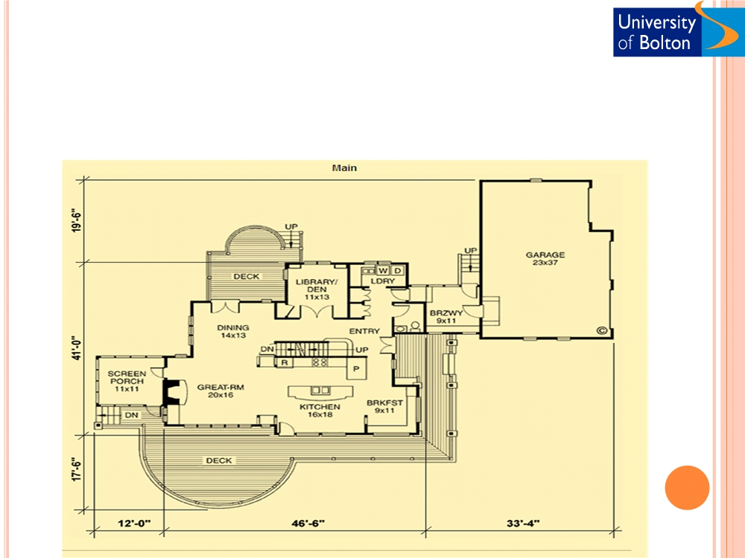
E-BUSINESS ARCHITECTURE
Architecture is ―an art and science of designing buildings and structures‖.
Blueprint helps the builder to be sure that every element of the home fits together properly.

Slide 4
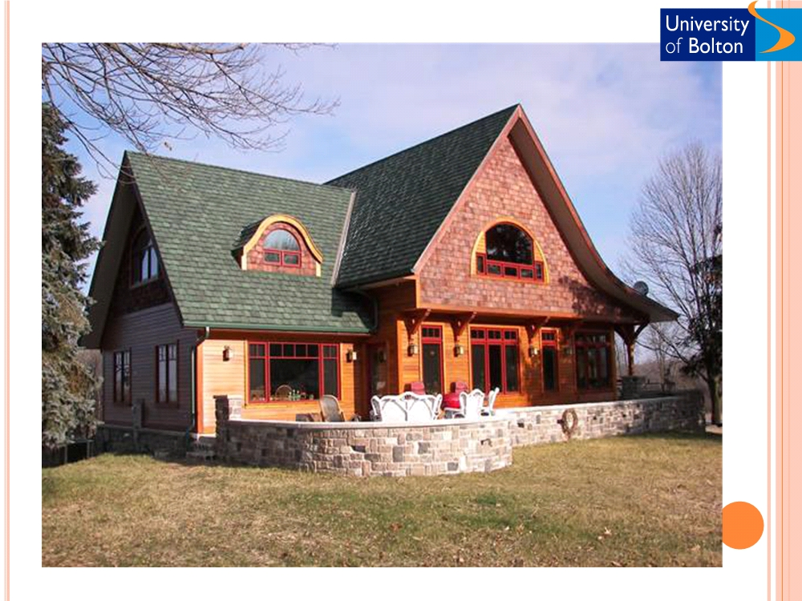

Slide 5
E-BUSINESS ARCHITECTURE
 An architecture (in the information technology context) is simply a guiding framework, or blueprint for delivering the applications and information
required by an organisation (Slyke & Belanger, 2003).
○ For instance making a digital video of product demonstration require:
○ Choosing a digital media server that is compatible with other component of overall e- business environment.
○ This should be done by consulting the e-business architecture
 An E-business architecture is a blueprint that is used to guide the delivery of applications and data related to an organisation‘s E-business activities
(Slyke & Belanger, 2003).
 An E-business architecture is a conceptual framework for the organisation of
the E-business infrastructure and applications (Turban et al., 2002).
○ A plan for the structure and integration of resources and applications  Defines how the various components of the environment fit together  Most organisations have IT architecture in place to:
○ Help and guide IT decisions
○ Act as a blueprint as in case of building a house

Slide 6
DEVELOPING AN E-BUSINESS ARCHITECTURE - A
SIMPLIFIED THREE LAYERED APPROACH (SLYKE &
BELANGER, 2003)
 Information layer
○ Comprises of guidelines that direct informatio creation, distribution and access
○ Involves information modelling,
Infrastructure
standardisation, control, and ownership
○ Building data models and business rules (UML)
 Applications layer
Application
○ Describes the environment in which the applications will operate
○ Describes applications that will implement business logic required by the organisation
○ Includes business and web applications
○ Business applications
 E.g. SCM systems and CRM systems
○ Web applications
Information
 E.g.. Web server and content management software
 Infrastructure layer
○ Describes the hardware, networks, and operating systems
○ Hardware
 Servers, PC‘s, Network devices, etc.  Operating systems
 Windows NT, Linux, and Mac

Slide 7
ELECTRONIC BUSINESS ARCHITECTURE
Information
-Data models
- Business rules
-Discovery tools
- Access rules
-Information security specification
Applications
- SCM
- Application server - Web application - Other application
- ERM
-CRM
- Groupware
Infrastructure
- Network access devices - Server hardware
- Network hardware
- Operating systems - Security services
- Development tools
- Other components
(Slyke & Belanger, 2003)

Slide 8
INFORMATION LAYER
○ Information layer represents:
 Organisation of the data used
 Individual data models for each application  Connection between applications  Data-oriented business rules
 Specifications for various data warehouses and data marts associated with e-business
 Information discovery tools (data mining software, data retrieval software, and search technology
 Information security specifications

Slide 9
APPLICATION LAYER
○ Business application
 Supply chain management systems
○ Help to manage the involved activities in producing and supplying a product/service to the end user.
 Customer relationship management systems
○ Help to organise customer information  Increase customer satisfaction
SCM
○ Increase profit
MRP
HRM
 Enterprise resource management systems
ERP
○ Help to connect various aspects of organisation‘s oper replacing separate, disconnected applications with a single
multi-mode application
FRM
CRM
 Groupware
○ Help to facilitate communication and information sharin among members of a group.
○ Messaging systems  Shared calendars
○ Shared discussion database  Document management

Slide 10
APPLICATION LAYER (BUSINESS LAYER) CON‘T
Business application
○ Electronic storefront software
○ Database management system
 Systems that help to provide shopping card, wish lists, and
 Helps organisations to create, maintain, and provide access to
product recommendation.
data.
○ Electronic catalogue software
 Sometimes included in infrastructure layer.
 Systems that help to provide product catalogues online.  Includes database import,
○ Workflow management software
product categorisation, and
 Helps organisations to cope with the tasks and procedural
product searching.
○ E-mail client software
steps to complete the steps in
 Software systems that allow users to manage email
business process.
 Typically concerned with the flow of documents throughout a process.
marketing campaigns and
messages.

Slide 11
APPLICATION LAYER CON‘T
Web application
○ Web server software
○ Other server software
 Store and deliver Web pages trough HTTP (HyperTest
 Electronic mail software
Transfere Protocol)
○ Handles e-mail related tasks on a network.
○ Application server software
 Multimedia servers
 Manage communication between Web browser client
○ Distributes various types of digital media files such
software and back-end applications and database. Typically associated with transaction-oriented applications.
as audio and video and still images.
 Groupware servers
○ Handles tasks associated with the operation of
○ Content management software
groupware applications.
 Helps in managing the processes of creating,
 Other servers such as
chat and fax server software
tracking, and deploying content.

Slide 12
INFRASTRUCTURE LAYER
[A] HARDWARE PLATFORM
 Network access devices
○ Personal computers, terminals, personal digital assistants, network-enabled kiosks, and mobile access devices.
 Server hardware
○ Help to utilise multiple processors and are expandable to
incorporate large primary and secondary storage capabilities.
Network Equipment
○ Switches to send data between different servers within a network
○ Reuters to connect different networks and enable packet transmission among the connected networks
○ load balancers helps evenly distribute inbound traffic across the web servers in large organisations.
○ Other network hardware

Slide 13
INFRASTRUCTURE LAYER CON‘T
○ [B] Development tools

Application development tools
○ Programming languages, Software development methodologies, Code generators, Component libraries, and report generators.

Web page development tools
○ Helps creating and managing web pages. (page verification, page layout, and add different functions)

Modelling tools
○ Helps in developing various e-business applications such as entity relationship models and data-flow diagrams.

Multimedia development tools
○ Create and edit various multimedia files

Document development tools
○ Create and maintain e-business documents. (adobe acrobat)

Testing environment tools
○ Testing tools, test case generation methods , test executing, monitoring, and reporting facilities.
○ [C] Operating systems
 Provide basic interfaces and software environment .(windows, Linex, Mac, etc)

Slide 14
INFRASTRUCTURE LAYER CON‘
○ [D] Security services
 Firewalls is a system that acts as a barrier between the internal network and outside world. It can screen both incoming and outgoing traffic.
 Backup and recovery systems
 Authentication is to establish the identity of a user before allowing access to various resources.
 Encryption is to scramble data into an unusable form to
prevent those who intercept the data in transit from being able to use it.
 Disaster recovery systems can be backing up data remotely, run parallel, duplicate systems at different locations.
○ [E] Other components
 Directory services
○ Electronic phone books  Network management
○ Fault management, configuration management, performance
management, security management, and providing statics on network usage, et.

Slide 15
DEVELOPING AN E-BUSINESS
ARCHITECTURE A SIX STEP PROCESS
○ Define business goals and vision
○ Define the information architecture  Define data architecture
○ Define application architecture
○ Define technical architecture
○ Define organisational architecture
(Koontz, 2000 in Turban et al., 2002)

Slide 16
DEVELOPING AN E-BUSINESS
ARCHITECTURE A SIX STEP PROCESS CON‘T
○ Step I: define business goals and vision
 What your organisation wants to achieve
○ Improving revenues and profit
○ Going global
○ Cost reduction
○ Improving customer service
○ Developing employee competence
 Business analysts and systems analysts review organisations business goals and visions
○ Describe how to achieve the stated business goals
○ Describe how technologies can be utilised to achieve business goals and vision
○ STEP II: Define information architecture
○ Define information necessary to fulfil the objectives of step-I
○ Examine each business goal
○ Identify the information available, needs, gaps, and challenges

Slide 17
DEVELOPING AN E-BUSINESS
ARCHITECTURE A SIX STEP PROCESS CON‘T
○ STEP III: Define data architecture
○ Determine exactly what data and information you want to get from the stakeholders such as customers (e.g. POS,
click stream data)
○ Investigate all information that flows
○ Within the organisation ( between functions/ divisions)
○ To and from the organisation (customers, business partners and suppliers)
○ May result finding data in mainframes, dispersed systems, excel files etc.
○ STEP IV: Define application architecture
○ Define the components or modules of the applications that will interface with the required data.
○ Build the conceptual framework of an application, but not the infrastructure that will support it
○ Describe security, scalability, and reliability
○ Vendors offer diverse application platforms - Microsoft, Oracle, IBM, etc.
○ Customisation may be necessary

Slide 18
DEVELOPING AN E-BUSINESS
ARCHITECTURE A SIX STEP PROCESS CON‘T
○ STEP V: Define technical architecture
○ Examine specific hardware and software required  Analyse existing IT systems and resources  Evaluation of required upgrades and acquisitions  Determine middleware applications needed  Selection of hardware and software from a range of vendors
○ Oracle - eBusiness suite
○ Sun Microsystems - Solaris  IBM - eServer Blade centre
○ STEP VI: Define the organisational architecture
○ An organisational architecture addresses the human resource issues to realise steps I - V
○ Analyse existing and required skills (e.g. IT expertise)
○ Adopt an appropriate strategy (in-house development or outsourcing)  Examine and address the legal, administrative, and financial constraints

Slide 20
E-BUSINESS:
APPLICATION DEVELOPMENT
PROCESS
○ Creating an e-business architecture
○ Selecting a development option
 Insourcing
 Outsourcing
○ Turnkey
○ Leasing
○ Other options
○ Installing, testing, and deploying e-business applications
○ Operation and maintenance

Slide 21
E-BUSINESS APPLICATIONS DEVELOPMENT: OPTIONS
○ Insourcing: In-house development
 Benefits
○ Better fit for organisation‟s business strategy  Differentiation from competition
○ Ownership and flexibility
 Challenges
○ Time consuming  Costly
○ Human resource constraints
 Options, issues and trends
○ Microsoft (IIS, .Net environment, SQL server… ), Sun (JSP, Oracle database…) etc.
○ Applications are rarely built from scratch
○ Applications are generally built from standard components

Slide 22
E-BUSINESS APPLICATIONS
DEVELOPMENT: OPTIONS CON‟T
○ Outsourcing (Turnkey, Leasing, and other options)
 Turnkey approach: Buy the applications
○ A turnkey approach involves buying a commercial package, installing it, and starting it up. While selecting a particular package, organisations should consider both
○ Current requirements
○ Future needs
○ Integration necessities (between multiple applications)
○ Major advantages
○ Several options (packages) are available with standard features  Saves time and money
○ Requires fewer personnel
○ Proven product functionality
○ Major disadvantages
○ Software may not exactly meet the company‘s needs  Inflexibility towards possible future changes  Loss of control
○ Integration challenges  Credibility of vendors

Slide 23
E-BUSINESS APPLICATIONS
DEVELOPMENT: OPTIONS CON‟T
○ Leasing
 On-premises installation
○ Vendor helps in installation, operation, and maintenance  Substantial cost and time savings
○ Practical and advantageous to SMEs
 Application Service Providers (ASP‟s)
○ Vendor hosts applications at its data centre and makes them available through web browser interface
○ Applications are managed remotely
○ Up gradation, scaling, maintenance etc.
 Advantages
○ Fast implementations
○ Low initial cost for application deployment
○ Low up gradation, maintenance and overall costs
 Concerns
○ Credibility of ASP vendor (financial and overall health of the vendor)
○ Security and control
○ Confidentiality of organisational information

Slide 24
E-BUSINESS APPLICATIONS
DEVELOPMENT: OPTIONS CON‟T
○ Other options
 E-marketplaces, exchanges, auctions, etc
○ A company plugs itself into an existing Web site (e.g. eBay, Amazon)
 Joint ventures and consortia
○ Several different partnership arrangements may facilitate e-Business application development (e.g. Covisint)
 Internet malls
○ An Internet mall consists of a single entry displaying a collection of electronic storefronts
 ISPs/ Telecommunication companies
○ In addition to providing Internet access to companies and individual users, a large number of ISPs and telecommunication firms offer hosting services (e.g.
BT Yahoo)
 Software houses
○ Many software companies offer a range of outsourcing services for developing, operating, and maintaining e-business applications (e.g. Oracle, IBM)

Slide 25
CRITERIA FOR SELECTING AN
APPLICATION DEVELOPMENT APPROACH
○ Flexibility
○ Information requirements  User friendliness
○ Hardware and software resources  Installation
○ Maintenance services
○ Vendor quality and track record  Estimating costs
○ Personnel
○ Technological evolution  Scalability
○ Sizing
○ Performance  Reliability  Security
(Turban et al., 2005)

Slide 26
VENDOR AND SOFTWARE SELECTION
 Identify potential vendors
 Determine the evaluation criteria  Evaluate the vendors and packages  Choose the vendor and package  Negotiate a contract
 Establish a Service Level Agreement (SLA)

Slide 27
Activity & discussion
○ Identify e-business architecture of a case organisation
 Consider both B2C and B2B dimensions
 If your organisation is not involved in eBusiness…..try to assume an e-business model and describe the architecture
 Describe the technical architecture specifically
 Your organisation‟s hardware and software systems  Examine human resource issues in-depth

