Slide 1
E-BUSINESS STRATEGY AND MODELS LECTURE 2
E-Business Models and E-business Ladder
DR. Collins C. Kachaka BSc, MSc, DBA (Cybersecurity), CCNA, CWNA, MCP, CEH, CHFI, ITIL, PCI DSS
Email : collinschi@gmail.com
© 2017

Slide 2
INTRODUCTION
Successful e-commerce firms have
business models that are able to :
○ Leverage the unique qualities of the web  Provide real value to customers
○ Develop highly effective and efficient operation  Avoid legal and social confusions
○ Provide profitable business results

Slide 3
What is a business model??

Slide 4
BUSINESS MODEL
○ A business model is defined as the organisation of product,
service and information flows, and the sources of revenues and benefits to suppliers and customers (Timmers, 1999)
○ A business model is a method of doing business by which a company can generate revenue to sustain itself (Turban et al.,
2002)
 Simply……A business model is a set of planned activities designed to result in a profit in a market place
 Business model is at the centre of a business plan
 A business model always takes into account the competitive environment  E-business enables creation of new business models
 An e-business model aims to use and leverage the unique qualities of the internet and world wide web (Timmers, 1998)
 E-business models range from simple to very complex types
 Providing an all inclusive listing of e-Business models is a never-ending task as new business models emerge rapidly (Slyke and Belanger, 2003)

Slide 5
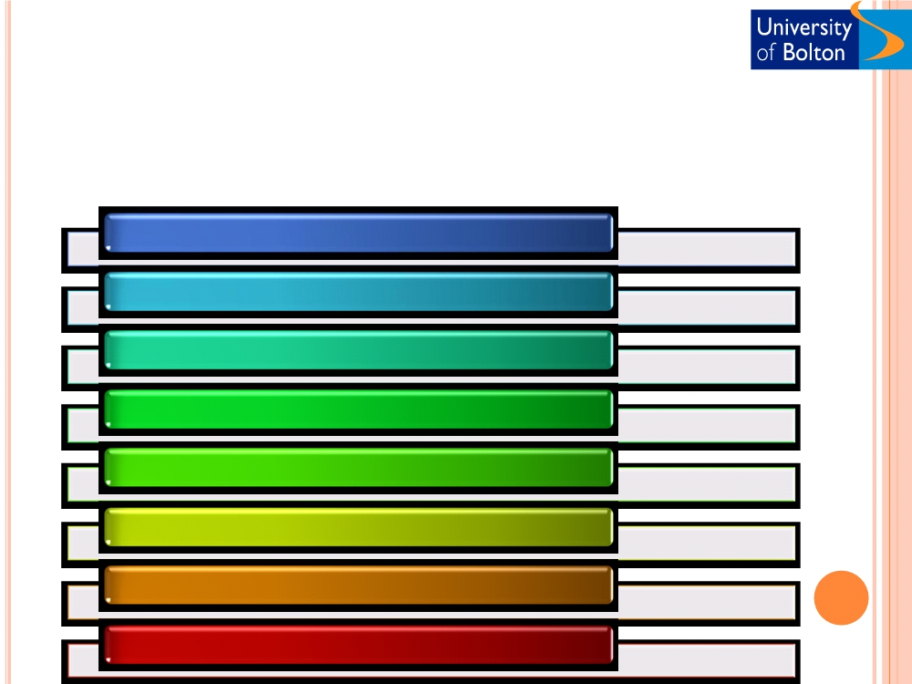
KEY ELEMENTS OF A BUSINESS MODEL
○ Developing a successful business model requires addressing:
1- Value proposition
2- Revenue model
3- Market opportunity
4- Competitive environment 5- Competitive advantage 6- Market strategy
7- Organisational development 8- Management team

Slide 6
VALUE PROPOSITION
○ Defines how a company‘s products and services fulfil the needs of customers.
○ Often developed by considering the market
condition. (Fresh direct, Starbuck‘s)
 Answer‘s the questions
○ Why customers choose the company?  Needs satisfaction
○ Value provision
○ What the company provides that others don‘t ?  Personalisation/ Customisation
○ Cost reduction/ Low price  Service delivery
 Facilitation of transactions  Managing product delivery
 Amazon (selection, convenience, personalisation),  Kozmo (product range, delivery)

Slide 7
REVENUE MODEL
○ An organisation's revenue model describes how it will earn revenue, generate profits, and generate a superior return on investment.
Profit alone are not sufficient to make a company successful. (Porter, 1985)  Generating profit is not enough
 ROI need to exceed alternative investments
○ The returns are greater than the company could obtain elsewhere. (saving account, real estate)
○ E-Business revenue models
Advertising model
Subscription model
Transaction fee
Offer content, service/product, forum for advertisement and receive fee
model
Offer high-value-added, premium that are not readily available elsewhere.
Receive a fee for enabling or executing a transaction
•Google.co.uk, yahoo.co.uk
Y! music
ebay.com, confused.com
Sales revenue model
Affiliate revenue model
Gain revenue by selling products, information or services
Receive fees for business referral
•amazon.com, LLBean.com, Gap.com
Epinions, Mypoint

Slide 8
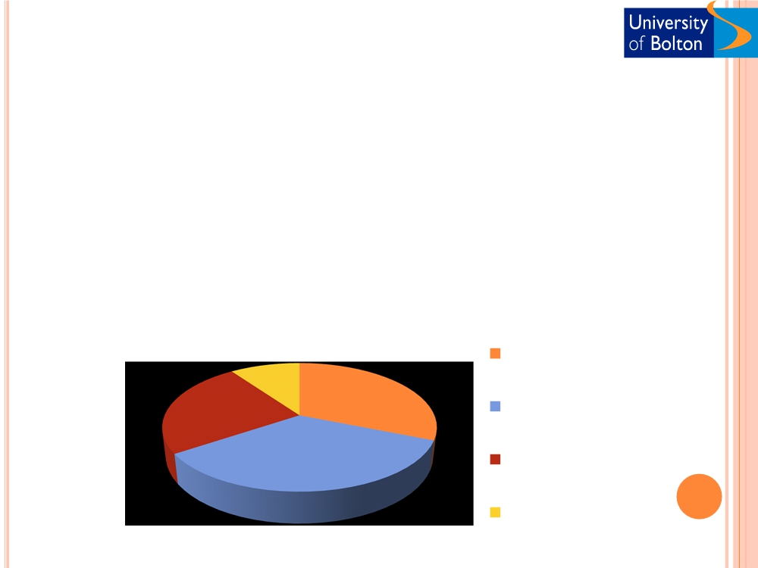
MARKET OPPORTUNITY
Newly identified need, want, or demand trend that a firm can exploit because it is not being addressed by the competitors.
○ The company‘s intended marketspace and the overall potential financial opportunities available to the firm. What opportunity do you see??
 It is divided into smaller market niches  Market size
 Revenue potential in each segment
Market space and Market opportunity in the software training market
Computer- based training $21 b
Small business $19 billion
10%
31%
25%
Furtune 500$30 billion
Instructor-le
training $49 billion
Small Business $6 billion
34%
Furtune 500$15 billion

Slide 9
COMPETITIVE ENVIRONMENT
○ An organisation‘s competitive environment constitutes other
organisations operating in the same market and selling similar products and services
○ Number of competitors  Large number
 Saturated market
 Difficult to become profitable
○ Small number or lack of competitors
 Untapped market niche ripe
 Has been unsuccessful before  Size of the competitors  Market shares
○ Pricing and Profit margins

Dimensions of competition  Direct competition
○ Sell very similar products/services (Google vs MSN, Priceline vs Travelocity)
○ Indirect competition
○ Different industries but their products can substitute for one another(airline vs automobile, CNN vs ESPN)

Slide 10
COMPETITIVE ADVANTAGE
○ Organisations achieve competitive advantage when they can produce a superior product and/or bring the product to a market at a lower price than most, or all, of their
competitors (Porter, 1985)
ELEMENTS of Competitive Advantage
Access to capital
 Favourable terms with suppliers, transporters, or sources of labour
 Loyal customers
 Knowledgeable base and loyalty of employees  Low cost labour resources
 Intellectual property - patents
 Asymmetries (financial, knowledge, information, and power)
○ Better products, faster, lower cost (Apple vs iTune)  First mover
 Unfair competitive advantage
 Leveraging competitive advantage (Amazon.com and auction arena )

Slide 11
MARKET STRATEGY
○ Market strategy is the plan that describes how you intend to
enter a new market, attract customers, and serve them profitably.
○ Marketing mix (Kotler and Keller, 2005)
○ Product:
 anything that can be offered to market
○ Price
 The amount of money charged to a product or service  Promotion
 Activities that communicate the product or service and its merits to target customers and persuade them to buy
○ Place
 Activities that make the product or service available to target customers
○ Examples (FreshDirect, AOL, Yahoo)

Slide 12
ORGANISATIONAL DEVELOPMENT
○ Organisational development describes how the company will organise the work that needs to be
accomplished
○ Start-ups - single entrepreneur
Organisational Structures
Expansion -Teams and organisational structure  Functional departments
○ Recruitment and training
○ Continuous employee learning

Slide 13
MANAGEMENT TEAM
○ Management team are the employees of the organisation responsible for developing and implementing the business
model
○ A Strong management team……….. has
○ Ability to give a model instant credibility to outside investors  Market specific knowledge and experience
○ Strategic expertise
○ A Strong management team……….can
○ Develop viable business models
○ Modify and redefine business model accordingly
○ Apply their expertise to changing business environment

Slide 14
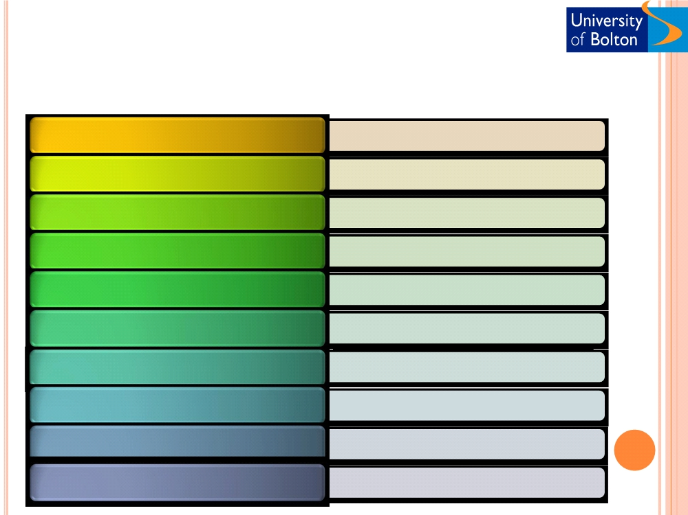
E-BUSINESS MODELS
E-shops
• Dabs.com
E-procurement
• Click2procure.com (Siemens)
E-malls
• Emall.com, msn shopping
E-auctions
• Ebay
Virtual communities
•Knowledgeboard.com
Collaboration platforms
• Yahoo Groups
Third-party marketplaces
• Moneysupermarket.com, Alibaba.com, Freemarkets.com
Value-chain integrators
• Paypal, Worldpay
Value-chain service providers
• FedEx, UPS
Information brokerage, Trust and other services
• Gartner, IDC

Slide 15
MAJOR CATEGORIES OF E-BUSINESS MODELS
There are many e-business models, and more are
being invented every day. It is difficult to categorise them because of :
 Fundamental similarities (E-distributors vs E-tailer)  Distinguishable by their market focus
 Involved technology (M-commerce vs e-tail)  Multiple business models (Ebay)
However, our approach is to categorise business models according to the different e-business sectors (B2B, B2C,C2C,etc).

Slide 16
MAJOR B2C BUSINESS MODELS
○ Portal  General
○ Transaction broker
 Online sales processors such as stock brokers and travel agents (e-trade,
○ Content and content search, service news, email, chat, music download,
travelocity, orbitz)
video streaming, Calendars, etc. (AOL)
 Specialised (Sailnet, SWP)  Search (google, ask.com)
○ Market creator
 Brings buyers and sellers together (ebay, priceline)
○ E-tailer
○ Service provider
 Virtual merchant
 Selling services (xdrive, myCFO)
○ Online store or E-shop (Amazon, virtual farmers market)
○ Community provider
 Bricks- and- click
 Social networks (Myspace, Facebook, about.com)
○ Online and physical store (Tesco)
 Catalogue merchant  Online version of direct mail
○ Content provider
catalogue (LLBean.com)
 Information and news (CNN, Sportline, wall street journal)
 Manufacturer direct
○ Manufacturer sell directly to customer (Dell, Sony)

Slide 17
MAJOR B2B BUSINESS MODELS
 E-distributor
○ Supply maintenance, Repair, Operation goods, Indirect inputs (grainger.com, partstore.com)
 E-procurement
○ Creating a digital market where sellers and buyers transact for indirect inputs (ariba, HUBWOO)
 Exchanges
○ Independently owned vertical digital marketplace for direct inputs (farms.com, foodtrader)
 Industry consortium
○ Industry-owned vertical digital market open to select suppliers (elemica, quadrem)
 Single firm
○ Company-owned network to coordinate supply chain with a limited set of partners (wal-mart, proctor & gamble)
 Industry wide
○ Industry-owned network to set standards, coordinate supply and logistics for industry ( agentrics)

Slide 18
C2C, P2P, AND M-COMMERCE
○ Customer to customer
 Connects customers to customers (ebay, half.com)
○ Peer to peer
 Technology enabling consumer to share files and services via the web, without a common server (Kazaa, cloudmark)
○ M-commerce
 Extending business application using wireless technology (ebay anywhere, paypal mobile, aol moviefone)

Slide 19
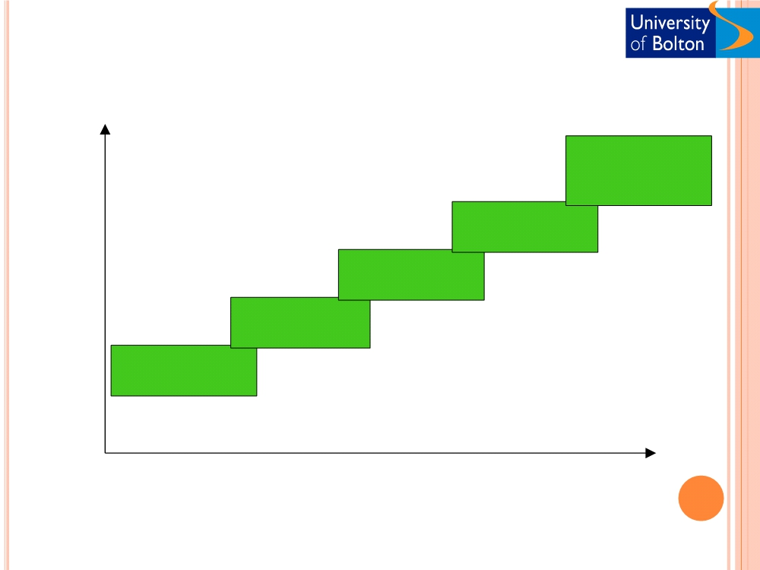
CISCO E-ADOPTION LADDER
transformed
Business
organisations
benefits
e-business
-open systems
of information
for customers,
e-commerce
-integrate
suppliers and
supply chain so
partners
manufacture
-order and pay
and delivery
- new business
website
online, reducing
become
models based
transaction seamless on
-place in
costs interworking
e-mail worldwide
- minimise between
market
- maximise waste at every organisations
- efficient internal
accessibility and stage of the and individuals speed supply chain
and external - window on
communications worldwide
suppliers
Extent of organisational change & sophistication
○ Cisco e-Adoption Ladder (DTI, 2000)
○ ( Adapted from Cisco led Information Age Partnership study on e-commerce in small business)

Slide 20
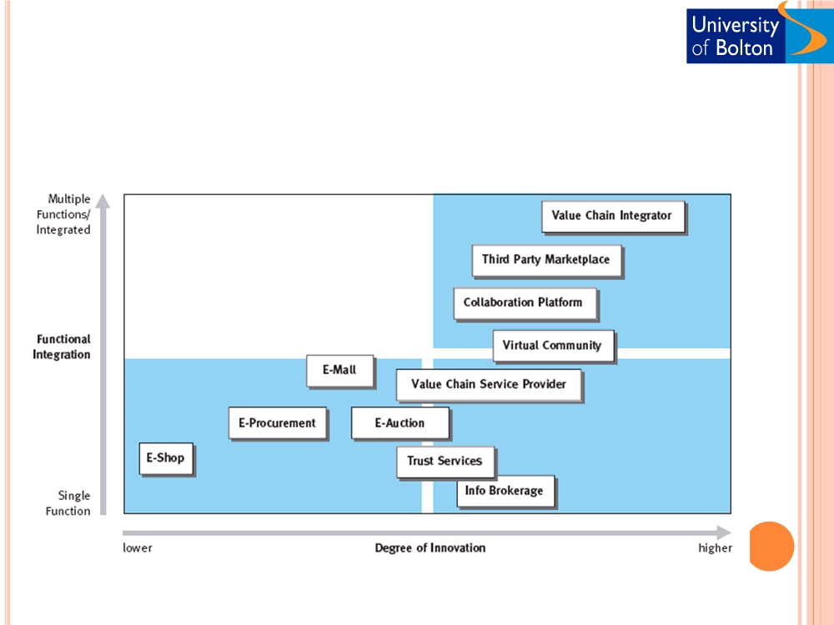
E-BUSINESS STATUS OF ENTERPRISES (TIMMERS, 1999)

Slide 21
PWC E-COMMERCE LEVELS (PWC, 1999)

Slide 22
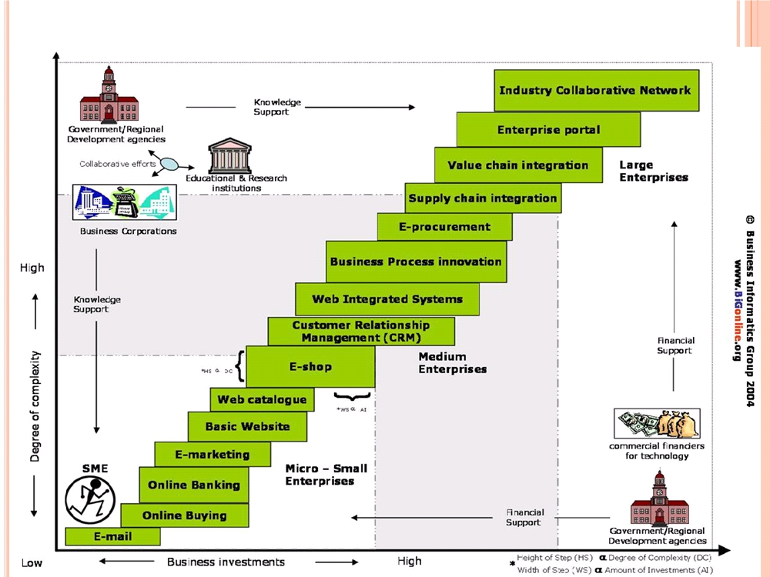

Slide 23
E-mail
 The starting point on the ladder is to use e-mail in speeding up the information flows and business communications with customers, employees and the associate organisations.
 Using email simply needs an Internet connection and involves reasonably low setup costs.
○ Online buying
 The next plausible step is to search and buy products on the Internet from a wide spectrum of suppliers thereby achieving cost, time and quality benefits.
 Online buying sometimes may require knowledge of using search engine technologies for finding required
products and suppliers.

Slide 24
ONLINE BANKING
 Online banking provides many benefits to businesses such as:
○ Saving time
○ Reduce costs and other resources  Easy to monitor transactions  Easy to manage
○ Convenient access
 Reaching this stage of the ladder requires some knowledge on web security for performing online banking transactions.
 Forrester (2001) suggests that banks can win online
SME relationships, by adding services like counselling and accounting connectivity to today's banking platforms. This will further enable businesses to streamline their business accounting and cut administration costs.

Slide 25
E-MARKETING
○ E-marketing can be a significant step in utilising Internet for strategic advantage and business growth. E-marketing may involve:
 Market research
 Product promotion
 Viral marketing or virtual marketing  Online advertising
 Customer service, etc.
○ Depending on the e-marketing strategy and its extent of
implementation, organisations often require knowledge on web technologies and their applications in business.
○ Effective utilization of e-marketing can facilitate businesses in reaching:
 Wider market  Segments
 Speed up promotional communications
 Provide significant marketing benefits at low costs.
○ The ability to respond electronically to the customer problems and demands instantaneously can help businesses in retaining customers and achieving competitive advantage.

Slide 26
BASIC WEBSITE
○ Developing a website for business can be
considered as the first earnest step towards e-
business, enabling organisations infinitely to
reveal their presence to wider markets across the
globe.
○ Today most of the websites are seen as a natural extension for businesses, with the potential of attracting prospective customers and business
partners.
○ Depending on the functionality and e-business strategy, business websites can involve significant investments on the technologies, people and knowledge.

Slide 27
WEB CATALOGUE
○ A web catalogue in its simplest form provides information on products and services of an organisation along with the
contact information on the website.
○ Some of the advanced websites use latest multimedia and other web technologies to provide interactive product demonstrations.
○ They can enable users to design, customise and view products.
○ An effective web catalogue can assist businesses to attract potential customers and can significantly improve the
brand image.
○ Prominent examples can be seen in apparel and automobile industries, which include highly interactive websites of
Nike, Mercedes-Benz and Opel.

Slide 28
E-SHOP
○ Establishing an e-shop can be an extension to an existing high street shop or it can be the only sales channel for
some businesses.
○ E-shops are seen as a low cost route for presenting and
selling products globally. They often provide low prices to
the customers compared to bricks and mortar outlets.
○ Building an e-shop requires significant investments and collaboration with online payment authorising agencies to provide security and customer confidence.
○ This step further involves managing the complexity arising from the changed business processes.

Slide 29
CUSTOMER RELATIONSHIP MANAGEMENT (CRM)
 Siebel (2004) defines CRM as ―an integrated approach to
identifying, acquiring, and retaining customers. By enabling
organisations to manage and coordinate customer interactions
across multiple channels, departments, lines of business, and geographies. CRM helps organisations maximise the value of every customer interaction and drive superior corporate performance‖.
 CRM involves:
○ Utilising advanced database technologies  Establishing business processes
○ Preparing people and systems to manage profitable customer relationships.
 We can find many online retailers using web integrated CRM systems in customer profiling and in developing customised
promotional offers on an individual basis (Amazon.com, Dabs.com and Ocado.com)
 Customised promotional offers provides promotions to
customers based on their purchase history, which helps these
companies in retaining and building a profitable customer base.

Slide 30
BUSINESS PROCESS INNOVATION (BPI)
BPI involves introducing new business processes and re-engineering existing processes by exploring and employing ICTs to improve performance.
Teng et al. (1994) define Business Process Re-engineering (BPR) as ―the critical analysis and radical redesign of existing business processes to achieve breakthrough improvements in performance measures‖.
This ability of organisations to continuously improve business processes through redesign and innovation can tremendously improve productivity, profitability,
responsiveness, and customer satisfaction.
In pacesetting organisations, fast and efficient processes have become a primary vehicle to leverage intellectual capital and competitive performance.
Reaching this step on the ―BiG e-business Ladder‖ involves gaining significant
knowledge on BPR, operations and knowledge management. It further needs
skills and investments to make use of pertinent Information and Communication Technologies (ICTs).

Slide 31
E-PROCUREMENT
○ E-procurement is the use of the Internet by buyers and sellers to access and exchange large amounts of data for B2B e-
commerce transactions (CIO 2003).
○ Reaching the e-procurement step on the ―BiG e-business Ladder‖, involves:
 Establishing processes  Infrastructure
 Systems for online procurement of materials.
○ E-procurement helps businesses to negotiate with a wider range of suppliers across the globe as opposed to the traditional form of procurement where they had to make contractual agreements locking the businesses with specific suppliers.
○ Research shows that businesses can reduce their total
purchasing budget by up to 8.5 percent through e-procurement
(CIO 2003).

Slide 32
SUPPLY CHAIN INTEGRATION (SCI)
○ SCI is a complex, advanced and extended form of e-
procurement, which also encompasses sell-side logistics.
○ Commission on Engineering and Technical Systems (CETS 2000) defines an integrated supply chain as ―an association of customers and suppliers who, using management
techniques, work together to optimise their collective
performance in the creation, distribution, and support of an end product‖.
○ SCI involves integrating an organisation‘s systems with supplier/partner‘s business systems. Reaching this step requires further capital and knowledge investments and provides many operational benefits by enhancing the visibility of information across the supply chain spectrum.

Slide 33
VALUE CHAIN INTEGRATION (VCI)
○ Value Chain Integration encompasses activities starting from, determination of customer needs through product/service
development, production/operations and distribution, including
first, second, and third-tier suppliers (Handfield and Nichols 2002).
○ At each stage, several functional divisions of an organisation or numerous organisations, add value to the product/service.
○ Apart from automobile industry examples of VCI can be
commonly seen in IT industry, wherein many organisations add value at various stages of developing large scale IT systems.
○ Individual organisations may involve at phases such as:
 Systems research
 Analysis
 Development  Integration  Testing
 Implementation  Training.

Slide 34
ENTERPRISE PORTAL
○ Enterprise Information Portals (EIPs) are the
applications that enable companies to unlock
internally and externally stored information, and provide users a single gateway to personalised
information needed to make informed business
decisions‖. (Shylakes and Tylman, 1998)
○ Establishing an enterprise portal and its effective utilisation involves a high degree of complexity
and demands organisations to make significant
investments and introduce change management.
○ These portals are commonly seen in large
corporations with a geographically distributed workforce, supporting them in collaborative
problem solving and product development.

Slide 35
COLLABORATIVE NETWORK
○ Collaborative networks involve virtual platforms, where
organisations with shared objectives cooperate with each other to solve problems, share expertise and develop innovative products.
○ These platforms provide a set of tools and an information
environment for collaboration between enterprises and individuals. They can focus on specific functions, such as collaborative design and engineering, or on providing project support with a virtual team of
consultants (Timmers 1998).
○ Establishing collaborative networks requires extensive knowledge amalgamation from various organisations. These networks can be seen in automotive design & manufacturing, large-scale software systems development, infrastructure development etc.
○ World Health Organization recently established a collaborative
network of clinicians for SARS diagnosis and treatment. Within this
network, individual hospitals throughout the world exchanged and
reviewed the diagnostic analyses, treatment results and case
management approaches, resulting in effective treatment and control of the disease.

Slide 36
SUGGESTED ADDITIONAL READINGS
1. Timmers, P (1999) Electronic commerce: Strategies and models
for business-to-business trading, John Wiley.
2.
Lawrence et al (1998) Internet commerce: Digital models for
business, John Wiley
3. Laudon K.C. and Traver. K.C., 2008, e-commerce business.
technology. society., Pearson international edition.
4. Oliver S., Kandadi KR., Kiran M. and Chinta AC (2004), ―The
impact of broadband on Small and Medium Enterprises‖,
Proceedings of the Ninth annual conference of The UK
Association of Information Systems (UKAIS), Glasgow, United Kingdom, 5th -7th May 2004.

Slide 37
ACTIVITY & DISCUSSION
 Select an organisation (e.g. your company)
○ Find existing and possible e-business models
○ Identify new business models - if any (not covered in class)
 Describe the ingredients of one of the identified business models
○ Value proposition
○ Revenue model
○ Market opportunity
○ Competitive environment  Market strategy
○ Organisational development  Management team
 Plot the selected organisation on the BiG e-business ladder
○ Describe the complexities and challenges involved in reaching each step

