Slide 1


E-BUSINESS STRATEGY AND MODELS
LECTURE 6
M-COMMERCE
Email : collinschi@gmail.com

Slide 2
Defining M-Commerce ?
Describing M-Commerce Infrastructure
Components
Factors promoting M-Commerce
Applications of M-Commerce
Benefits of M-Commerce
Limitations of M-Commerce

Slide 3

M-COMPUTING AND M-COMMERCE
○ M-computing refers to the ability to move computer
services around with individuals, using mobile
technologies including; mobile phones, Personal
Digital Assistants (PDAs), handheld computers, and
other handheld devices.
○ Mobile commerce also known as M-commerce and M-
business is any e-commerce or e-business done in a
wireless environment, especially via internet. M-
commerce is not merely a variation on existing
internet services; it is a natural extension of e-
business. (Turban, 2004)

Slide 4
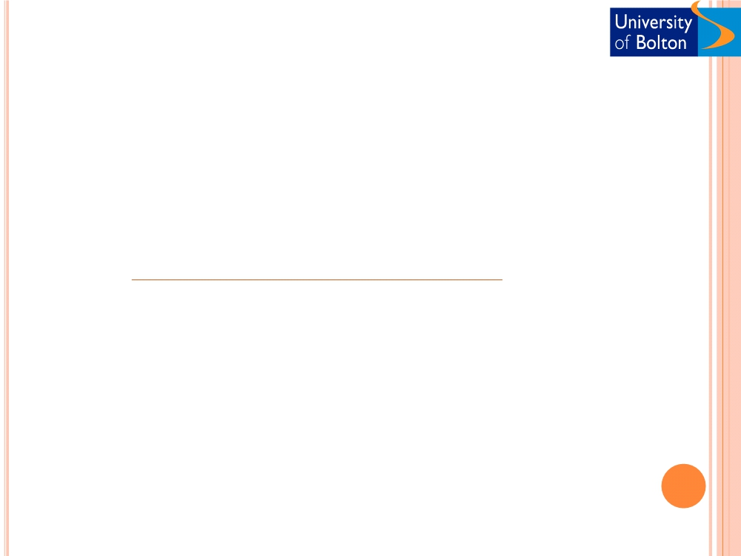
M-COMMERCE TECHNOLOGY
○ 1G. The first generation of wireless technology. It was an analog-based
technology in effect from 1979-1992.
○ 2G. It is based on digital radio technology and mainly accommodates text.
(introduced by NTT DoCoMoin 1991, it is used in Japan).
○ 2.5G. An interim technology based on GPRS(General Packet Radio Service,
a new mobile phone standard) and EDGE (Enhanced Data GSM
Environment) that can accommodate limited graphics.
○ 3G. Supports rich media such as video clips. It started in 2001 in Japan,
reached Europe in 2002, and to reach US in 2003.
○ 3.5G. Evolved HSPA/HSPA+ (High Speed Packet Access) allows networks
based on Universal Mobile Telecommunications System (UMTS) to have
higher data transfer speeds and capacity (42 Mbit/s). (Known as video
phones as they support video calls and broadband speed access).
○ 4G. It will provide faster display of multimedia. The international
telecommunications regulatory and standardisation body has set a rough
timescale of between 2012 and 2015 for 4G mobile broadband networks to
be rolled out commercially. The following objectives for 4G broadband have
been created:
 4G mobile broadband will be capable of speeds between 100Mbps and 1Gbps
available in both outdoor and indoor environments.
 4G broadband will be fully IP-based over a fully integrated system.
 Both the best quality of service and the highest levels of security will be offered
over 4G broadband networks.

Slide 5
M-COMMERCE TECHNOLOGY CON‘T
○ GPS. Satellite-based tracking system that enables the determination
of a GPS device‘s location.
○ Personal digital assistant (PDA). A small portable computer
wireless computer. (Palm, handhelds, pocket PC devices).
○ Short message service(SMS). It exist since 1991 and allows sending
short text messages.
○ Enhanced Messaging Services (EMS). An extension of SMS that is
capable of simple animation, tiny pictures, and short melodies.
○ Multimedia Messaging Services (MMS). The next generation of
wireless messaging; this technology will be able to deliver rich media.
○ Wireless Application Protocol (WAP). A technology that offers
internet browsing from wireless devices.
○ I-mode. Is the Japanese standard which uses a derivative of HTML
for content display. ( mobile phone ring tones and music download).
○ Smartphones. Internet enabled cell phones that can support mobile
applications. The include WAP microprocessors for internet access.

Slide 6
MOBILE COMPUTING INFRASTRUCTURE
○ Hardware
 Mobile phones
 Attachable keyboard
 PDAs
 Interactive pages
 Screenphones
 E-mail handhelds
 WAN modem
 Web server with a WAP gateway
 Database server
 AGPS locator
○ Mobile networks
 Module (SIM) card
 Wireless LANs

Slide 7
MOBILE COMPUTING INFRASTRUCTURE
CON‘T
○ Software
 Microbrowser. (access the web via wireless internet)
 Mobile client operating system
 Bluetooth. (enables voice and data communication)
 Mobile application interface
 Back-end legacy application software. (resides on large UNIX
servers from vendors Sun, IBM, and HP)
 Application middleware. (communicates with back-end legacy
systems and web-based application server)
 Wireless middleware. (links multiple wireless networks to
application server)
 WAP. (communication protocols that enable various kinds of wireless
devices to talk to a server)
 Wireless Mark-up Language (WML). (scripting language used
for creating content )
 Voice XML

Slide 8
MOBILE APPLICATIONS
○ SMS applications
 Texting is one of the useful tools for businesses. (banks, marketing
(youth market), supply chain management, etc).Examples of text
applications:
○ Database building/direct response to ads/direct mail or on-pack
○ Location based services ( find nearest pub, club, shop, or taxi,
pay congestion charge through texting)
○ Sampling /trial
○ Sales promotions
○ Rewarding with offer for brand engagement (ring tones,
wallpaper, java games or credits can be offered through text)
○ Short codes (scan the promotional code by mobile phone camera
and linked through directly to a website)
○ Offering paid for WAP services and contents.
(Chaffey, 2009)

Slide 9
MOBILE APPLICATIONS CON‘T
○ Wi-Fi (Wireless-Fidelity) mobile access
 Mobile intra-business and enterprise applications
○ Support of mobile employees
○ Customer support (CRM system)
 Mobile B2B and supply chain applications
○ Bluetooth wireless applications
 Proximity marketing (Local marketing campaigns)
○ Viral communication
○ Community activities
○ Location based services (electronic coupons as you pass a store)

Bluecasting
○ Send sample music track
 Bluejacking
○ Sending a message from a mobile or transmitter to another
mobile phone which is in close rang via bluetooth
technology.
(Chaffey, 2009)

Slide 10
POPULARITY OF MOBILE APPLICATIONS
○ Research by Wireless Intelligence (2008)
○ At the end of 2008, globally there were 4 billion subscriber connections
○ If there was one active subscription per person that would represent half the
planet's population.
○ Adaptation is low in developing countries such as India (21%) and China
(41%) showing the potential for future growth.
○ Even so, there are over half a billion mobile subscribers in China
○ More than 1 billion mobile phones were sold in 2007
○ It took 12 years to get to 1 billion GSM connections and just 30 months to get
to 2 billion
○ GSM is used by over 3 billion people in more than 212 countries
○ There are 1.2 million new GSM connections every day
○ Use of web by mobile in Japan is equal to that of traditional computer access.
○ The 2009 global economic crisis has affected the mobile telephony market but
did not stop its growth. (6.0% below the previous year).

Slide 11
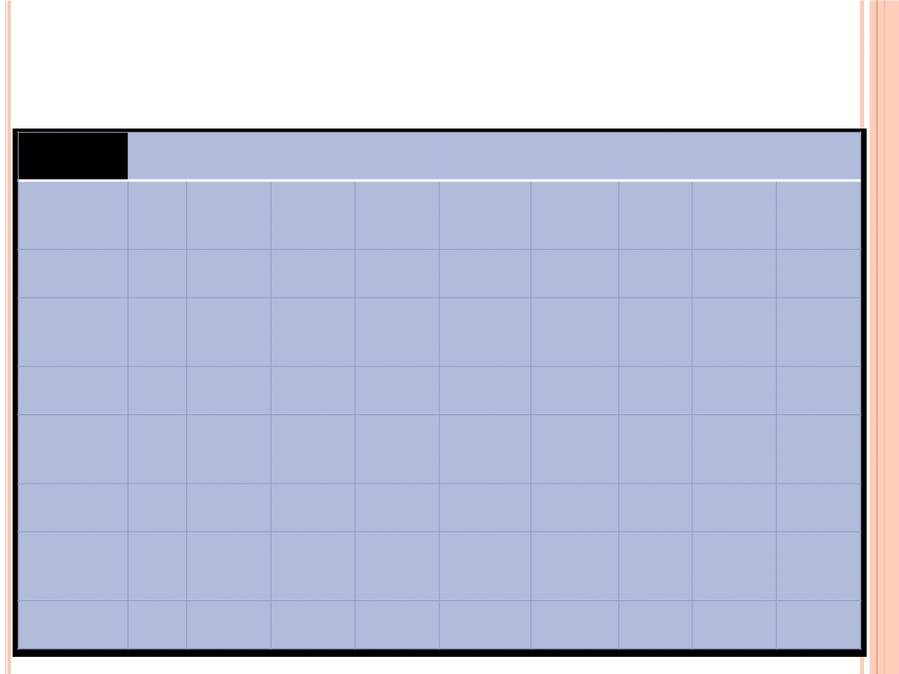
KEY GLOBAL TELECOM INDICATORS FOR THE WORLD
TELECOMMUNICATION SERVICE SECTOR IN 2010
Global Developed
nations
Developing Arab
Asia & The
Africa
nations States
CIS Europe
Pacific Americas
Mobile cellular
subscriptions
5,282
1,436 3,846
333 282
2,649 364
741 880
Per 100 people
76.2%
116.1%
67.6%
41.4%
79.4%
67.8%
131.5%
120.0%
94.1%
Fixed
telephone lines
1,197
506 691
13 33
549 74
249 262
Per 100 people
17.3%
40.9%
12.1%
1.6%
9.4%
14.0%
26.6%
40.3%
28.1%
Mobile
broadband
940
631
309
29
34
278
72
286
226
subscriptions
Per 100 people
13.6%
51.1%
5.4%
3.6%
9.7%
7.1%
25.9%
46.3%
24.2%
Fixed
broadband
555
304
251
1
8
223
24
148
145
subscriptions
per 100 people
8.0%
24.6%
4.4%
0.2%
2.3%
5.7%
8.7%
23.9%
15.5%

Slide 12
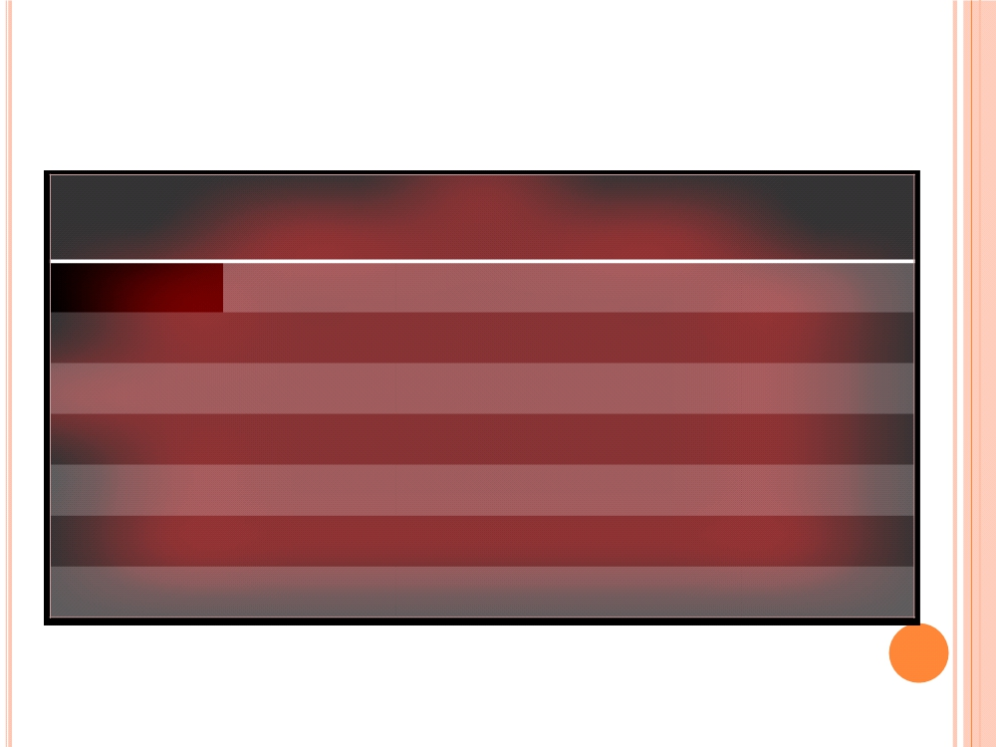
Worldwide Mobile Terminal Sales to End Users
in 2009 (Thousands of Units)
2009
2008
Market
Market
Company
2009 Sales
Share (%)
2008 Sales
Share (%)
Nokia
440,881.6
36.4
472,314.9
38.6
Samsung
235,772.0
19.5
199,324.3
16.3
LG
122,055.3
10.1
102,789.1
8.4
Motorola
58,475.2
4.8
106,522.4
8.7
Sony Ericsson
54,873.4
4.5
93,106.1
7.6
Others
299,179.2
24.7
248,196.1
20.3
Total
1,211,236.6
100.0
1,222,252.9
100.0
Gartner (February 2010)

Slide 13
BENEFITS OF MOBILE APPLICATIONS
Mobility
Broad reach
Ubiquity: being available at any location at any given time.
Location-based services: can provide geographically based
services, e.g. an offer in a particular shopping centre
Continence: easy and fast and easy access to information.
3G services is always on avoiding the need for lengthy
connection.
 Privacy: more private that a desktop access.
 Personalisation: personal information can be requested by
the user.
 Security
Examples: Google Android, the most interesting location based
applications. (GoCard price comparison, Ecorio, TuneWiki social
media player, Wertago)
(Chaffey 2009; Turban 2004)

Slide 14
Benefits of M-Commerce and Its Economic Advantages
  Mobility—users carry cell phones or other mobile devices
  Broad reach—people can be reached at any time
  Ubiquity—easier information access in real-time
  Convenience—devices that store data and have Internet, intranet, extranet connections
  Instant connectivity—easy and quick connection to Internet, intranets, other mobile devices, databases
  Personalization—preparation of information for individual consumers
  Localization of products and services—knowing where the user is located at any given time and match service to them

Slide 15
M-COMMERCE OBSTACLES (LIMITATIONS)
○ Lack of common Mobile Standards
○ Limitation of Screen Size
○ Cant work without back-office systems
○ Privacy, security, socio professional issues
○ Knowledge of user‟s exact location is a disadvantage at times
○ Transaction protection
○ Limitations of Keyboard Sizes
○ Easy to lose and steal
○ Cost
○ Implementation

Slide 16
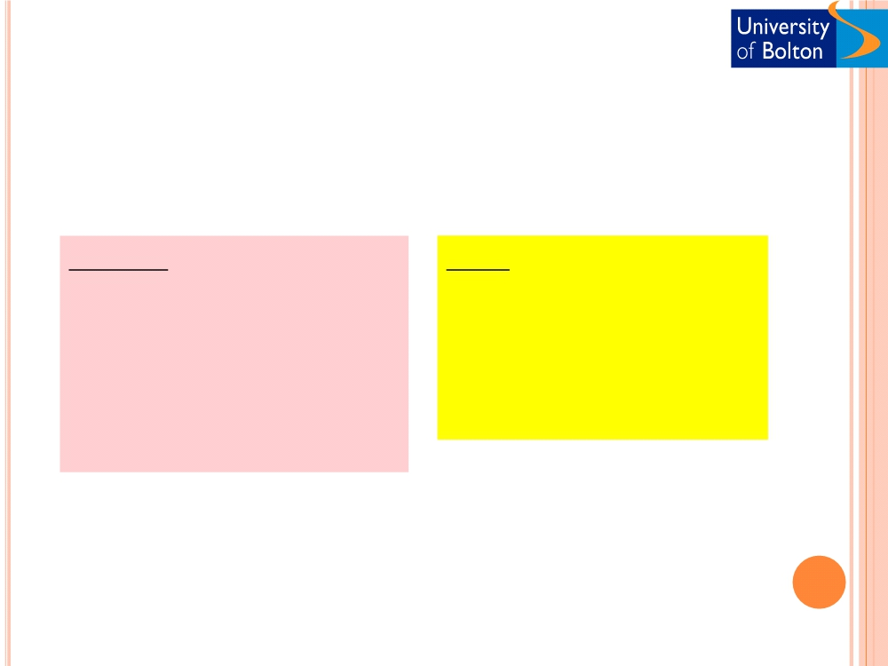
WAP SURVEY: - GENERAL IMPRESSIONS
Dislike
Like
❑ 5% Small Screens
❑ 15% Bad navigation
❑ 15% Data quality
❑ 15% Nothing
❑ 5% Novelty value
❑ 15% Portability
❑ 25% No depth or links
❑ 40% Slow connection
❑ 65% Access to news

Slide 17
FACTORS PROMOTING M-COMMERCE (DRIVING) FORCES
Affordability
User Friendliness
Widespread availability of devices
No need for a PC to carry out any work. Mobile Device is enough
Portable (ease to carry)
❑ The handset culture, proliferation of mobile devices,
cost, and specifications
❑ Vendor‟s push
❑ Declining prices (CHEAP)
❑ Improvement of INTERNET Bandwidth
❑ Service economy and customer service
❑ Mobility
❑ Productivity
❑ Efficiency through BPR
❑ Improved services
❑ Competitive advantage

Slide 18
Mobile Service Scenarios
Financial Services.
Entertainment.
Shopping.
Information Services (NEWS BULLETINS ON MOBILE).
Payments.
Advertising.
Agriculture
Education
Health Services nd more ...

Slide 19
APPLICATIONS of M-COMMERCE
(More on Information sharing and less on revenue generation)
Entertainment
  Music
  Games
  Graphics
  Video
  Pornography
Communications
  Short Messaging
  Multimedia Messaging
  Unified Messaging
  e-mail
  Chatrooms
  Video - conferencing
M- commerce
Transactions
  Banking
  Broking
  Shopping
  Auctions
  Betting
  Booking & reservations
  Mobile wallet
  Mobile purse
Information
  News
  City guides
  Directory Services
  Maps
  Traffic and weather
  Corporate information
  Market data

Slide 20
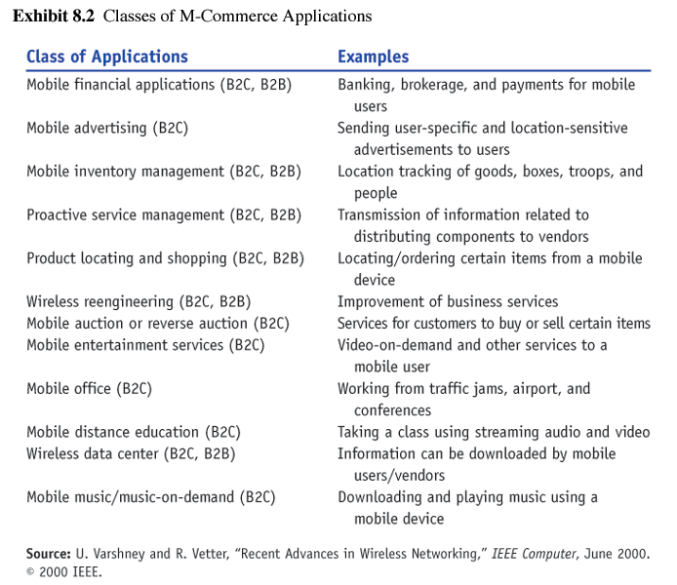
Classes of M-Commerce Applications

Slide 21
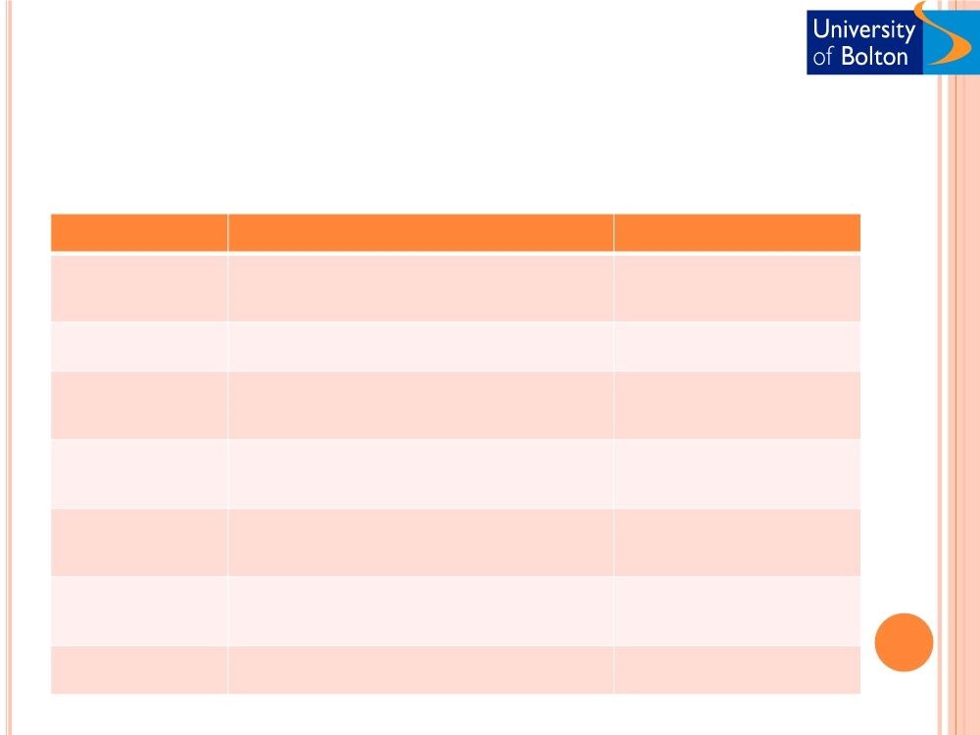
M-COMMERCE VALUE CHAIN
○ M-commerce is a complex process involving a number of
operations and a number of players (customers, merchants,
mobile operations, etc). (Turban, 2004)
Link
Function
Provider
Transport
Maintenance and operation of the
Technology platform vendors
infrastructure supporting data communication
between mobile users and application providers
Enabling services
Service hosting, data backup, and system
Infrastructure equipment
integration
vendors
Transaction
Mechanisms for assisting with transactions,
Application platform vendor
supports
security, and billing
Presentation
Convert content of web-based application to
Application developer
services
mobile device applications
Personalisation
Gather users preferences, information and
Content provider
support
devices in order to provide individualized
applications
User applications
General and specialised applications for mobile
users
Mobile service provider
Content aggregators
Design and operate portals that offer
Mobile portal provider
categorised information and search facilities

Slide 22
M-COMMERCE STRATEGY
❑ Analysis
❑ Competition
❑ Value to stakeholders
❑ Available technology and infrastructure
❑ Privacy, security, socio professional issues
❑ Strategic planning
❑ Implementation, modular approach
❑ Review

Slide 23
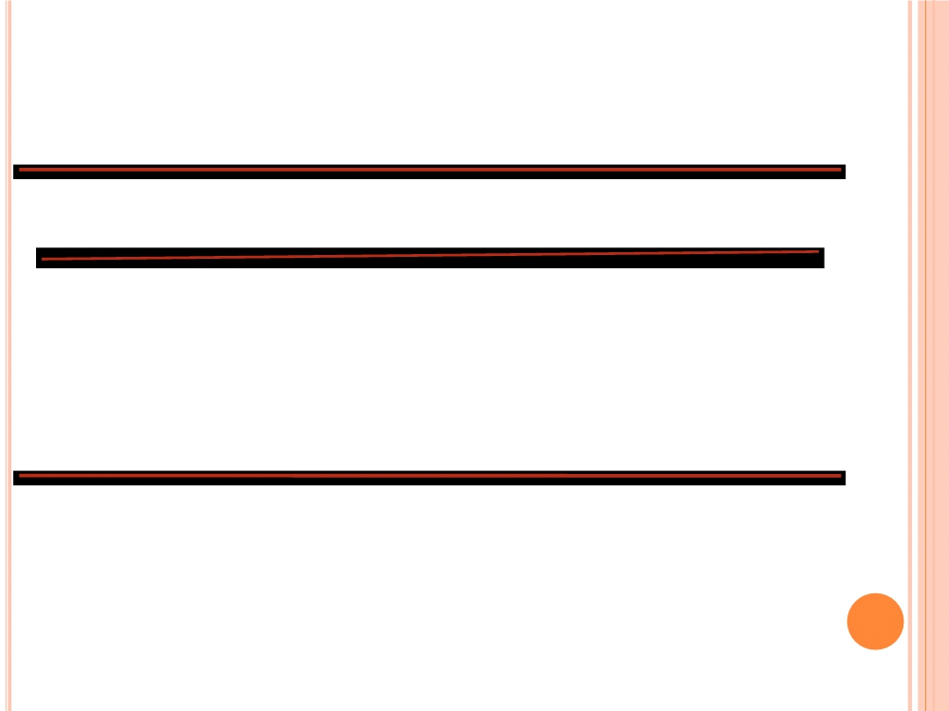
Mobile devices used to access the Internet away from
home/work, by sex, 2009 and 2010
Men
Women
All
2009 2010
2009
2010
2009
2010
Per cent
Mobile phone
29
37
18
25
23
31
Handheld computer (palmtop, PDA)
7
5
2
2
5
4
Portable computer (laptop)
29
30
23
22
26
26
None of the above
54
48
66
60
60
54
Base: UK adults who accessed the Internet in the last three months.

Slide 24
M-COMMERCE
○ Pros and cons
❑ M-commerce is here to stay
❑ Global m-commerce revenue is increasing. Google‘s gross revenue from mobile
advertising is over US$1 billion per year, Mobile marketing and advertising
expenditures in Japan in 2009 was US$1.14 billion.
❑ Materialise in some form
❑ How to proceed?
❑ Scanning the horizon for future opportunities
❑ Researching M-commerce technology
❑ Modular approach
❑ Wireless-enabling a portion of site
❑ Commercialised Internet
❑ Experience and position
❑ M-commerce and …………..
❑ Not a replacement, but extension
❑ Mandatory not optional
❑ What customer needs could be served with M-commerce

Slide 25
ACTIVITIES
○ Compare traditional and mobile support at an
airport and a hotel.
○ Explore nokia.com. Prepare a summary of the
types of mobile services and applications nokia
currently supports and plans to support in the
future.

