Slide 1
E-BUSINESS STRATEGY AND MODELS LECTURE 4
E-business Strategy Formulation
Implementation and Assessment
DR. Collins C. Kachaka BSc, MSc, DBA(Cybersecurity)
CCNA, CWNA, MCP, CEH, CHFI, ITIL, PCI DSS
Email : collinschi@gmail.com
© 2017

Slide 2
TABLE OF CONTENTS
○ E-business strategy formulation
 E-business strategy formulation tools
 Issues in e-business strategy formulation
○ E-business strategy implementation
 Activities and tools for strategy implementation  Issues in strategy implementation
○ E-business assessment
 Activities and tools for strategy assessment  Issues in strategy assessment

Slide 3
E-BUSINESS STRATEGY FORMULATION
○ The development of strategies to exploit opportunities and manage threats in the
business environment in light of corporate
strengths and weaknesses (Turban et al., 2006).
○ Elements impacting e-business strategy formulation
 Economic and business environment  Competitive environment
 Current business position
 Business portfolio (SBU‟s/ products/ services)  Technological environment and capabilities  Knowledge and innovation capabilities  Business partnerships/collaborations  Customer base
 Resource capabilities and allocation

Slide 4
STRATEGY FORMULATION
○ Activities and outcomes
 E-business opportunities and selection
○ Scenarios for future development
○ How the scenarios fit with future direction
○ Assess the relevance of current activities to the company‟s future  Outsourcing or eliminating some activities
 Cost-benefits analysis
○ Financial, non-financial, tangible, intangible, short term or long term
 Determining an e-business application portfolio
○ Current and future strategic importance of IS
 Risk analysis, assessment, and management
○ Risk of proposed opportunities
 Specific outcomes will be:
○ List of approved e-business projects or applications  Risk management plans
○ Pricing strategies
○ Tools
 BCG growth-share matrix
 Return on Investment (ROI)  Scenario planning
 GE Multifactor business portfolio matrix  Strategic SBU model
 Road mapping

Slide 5
OUTCOME OF
STRATEGY FORMULATION STAGE
SELECTION OF A VIABLE STRATEGY FOR USE
ACTIVITY PRIORITY LIST
SHORT TERM AND LONG TERM OBJECTIVES
RISK ANALYSIS REPORT
COMPANY COMPETITIVE ADVANTAGE REPORT
BUSINESS PLAN

Slide 6
STRATEGY FORMULATION TOOLS
○ BCG growth-share matrix
 A portfolio analysis tool developed by the Boston Consulting
Group (BCG) which helps managers develop organizational
strategy based on market share of businesses and the growth of markets in which businesses exist.
○ It compares projects on potential market growth and market share to determine the best projects to adopt, redesign, sell, or abandon.
○ BCG Growth-Share Matrix involves identifying the organization‟s strategic business units (SBUs).
○ A strategic business unit is a significant organization segment that is analyzed to develop organizational strategy aimed at generating future business or revenue.
○ An SBU varies from organization to organization. In larger organizations, an SBU could be a company division, a single product, or a complete product line. In smaller organizations, it might be the entire company.
○ Although SBUs vary drastically in form, all SBUs are a single business (or
collection of businesses), have their own competitors and a manager accountable for operations, and can be independently planned for.

Slide 7
BCG GROWTH-SHARE MATRIX
Strategy

Slide 8
BCG GROWTH MATRIX CON‘T
• Cash cows
• SBUs with high market share in a slow-growing industry. Generate cash in excess of the amount needed to maintain the business.
• E.g. Oracle in Database market
- HP in printer market - BT in
conventional telephony
• Dogs: SBUs with low market share in a mature, slow-growing industry. Generate barely enough cash (Break-even) to maintain the business's market share.
• E.g. IBM‘s PC hardware business unit - General Motors in SUV market in USA.
• Question marks: SBUs with low market share in a fast-growing
industry. Require large amounts of cash to grow their market share.
• E.g. Creative and Philips in MP3 player market - Ocado.co.uk in online grocery market
- Yahoo‘s search engine business.
• Stars: SBUs with a high market share in a fast-growing industry. The hope is that stars become the next cash cows. Sustaining the business unit's market leadership may require extra cash.
• E.g. Tesco.co.uk in online grocery market - Apple‘s IPOD in MP3plaer market - Google‘s search engine business - Sony (PS2) in gaming market.

Slide 9
STRATEGY FORMULATION TOOLS
○ Return on Investments (ROI)
 A ratio of required costs and perceived benefits of a project or an application.
○ A quantitative financial measure of costs and benefits
○ In basic terms, ROI quantifies the financial benefits of a project after subtracting the associated costs.
 Before funding an e-business initiative, managers use ROI analysis to determine which projects merit funding.
○ They may revisit ROI at the end of the project to measure actual performance.
 Performing ROI
○ Definition of a clear set of goals for e-business projects  Objectivity of ROI analysis
○ Choosing the right metrics
○ Measuring actual performance against the plan.  Avoiding ROI in irrelevant projects

Slide 10
STRATEGY FORMULATION TOOLS
○ Scenario planning
 Scenarios are a set of plausible outcomes that serve as the answer to a question or problem. These outcomes are bounded by key drivers of the issue at hand. (Market, competition, technology, innovation, economic etc.)
 Using this tool organisations generate, and prepare for several plausible alternative future business circumstances.
 The original scenario planning methodology called for the identification of two key drivers of the issue
at hand. These two drivers would provide the
boundaries for a 2×2 matrix.
 Planners would then elaborate the scenarios from this matrix, examining key environmental forces.

Slide 11
SCENARIO PLANNING CON‘T
○ Steps of scenario planning
1.
Scoping
○ What is the question/issue you want to answer/address ?
2.
Trend analysis
○ Identify external forces and their pressure on the business
3.
Building scenarios
○ Using the outcome of the first two stages and build scenarios
4.
Generate options
○ Consider innovation, opportunities, new services or projects within the scenario
5.
Test options
○ Identify positional implications and impacts of scenario on the identified options
6.
Action plan
○ Define an action plan as a result of the above activities
(JISC InfoNet.co.uk)

Slide 12
STRATEGY FORMULATION TOOLS
○ GE Multifactor business portfolio matrix
 Help managers develop organizational strategy that is based primarily on market attractiveness and business strengths. Developed by GE and McKinsey
 Evaluate relative attractiveness of various business
alternatives (SBU‟s). Typically, the SBU‟s are evaluated along two dimensions.
○ Industry attractiveness (Market size, growth rate, and intensity of competition)
○ Business position (Market share, share growth, and product strength)
 Steps
○ Assign relative weights to each relevant factor  Rate each SBU along each factor
○ Sum the weighted ratings to determine the position of each SBU

Slide 13
GE MULTIFACTOR BUSINESS PORTFOLIO MATRIX CON‘T

Slide 14
STRATEGIC BUSINESS UNIT (SBU)
MODEL TOOL

Slide 15
STRATEGY FORMULATION TOOLS; ROAD
MAPPING
In strategy formulation, the road-mapping approach helps to choose and do the right things. Road-mapping leads to effective:
○ Project portfolio development and management
○ Technological strategy assessment and development  Project evaluation and strategic alignment  Provision of a common language for innovation
○ Building of bridges between technologists and business managers.
(Solmon consulting , 2010)

Slide 16
ISSUES IN E-BUSINESS STRATEGY
FORMULATION
○ Channel conflict
 Channel conflicts arise when an existing company creates an additional distribution channel online
 These conflicts can be handled in several ways
○ Let established distributors handle e-business fulfilment (e.g. Electricals)  Provide online services to intermediaries (partners)
○ Sell limited products online (e.g. Mobile phone operators)  Avoiding online sales totally (e.g. Auto industry)
○ Online Vs Offline conflict
 In businesses with both online and offline businesses, resource allocation can be a complex problem
 Becoming competitors to each other
 Offline side handling logistics and after sales service  Needs appropriate change management from top level
○ Pricing strategy
 Price becoming a single determining factor for online performance
 Differential pricing strategies for online and offline sales

Slide 17
E-business strategy implementation
 The development of detailed, short-term plans for carrying out the projects agreed on in
strategy formulation

Slide 18
STRATEGY IMPLEMENTATION
○ At this phase the emphasis shifts from

“what do we do?”……….. To……… “how do we do it?”.
○ Develop and implement detailed short-term plans to carry out the projects agreed on at the formulation stage
○ Activities and Outcomes
 Evaluate specific options and establish specific milestones  Allocate resources
 Manage projects
○ Strategy Implementation activities/ tools
 Project planning
 Resource allocation  Project management
 Business Process Reengineering (BPR)  Pilot projects

Slide 19
STRATEGY IMPLEMENTATION IS THE TRANSLATION OF CHOSEN STRATEGY INTO ORGANIZATIONAL ACTION SO AS TO ACHIEVE STRATEGIC GOALS AND OBJECTIVES.
AN ORGANIZATIONAL CONTROL SYSTEM IS ALSO REQUIRED. THIS CONTROL SYSTEM EQUIPS MANAGERS WITH MOTIVATIONAL INCENTIVES FOR EMPLOYEES AS WELL AS FEEDBACK ON EMPLOYEES AND ORGANIZATIONAL PERFORMANCE. ORGANIZATIONAL CULTURE REFERS TO THE SPECIALIZED COLLECTION OF VALUES, ATTITUDES, NORMS AND BELIEFS SHARED BY ORGANIZATIONAL MEMBERS AND GROUPS.
FOLLOWING ARE THE MAIN STEPS IN IMPLEMENTING A STRATEGY:
DEVELOPING AN ORGANIZATION HAVING POTENTIAL OF CARRYING OUT STRATEGY SUCCESSFULLY.
DISBURSEMENT OF ABUNDANT RESOURCES TO STRATEGY-ESSENTIAL ACTIVITIES.
CREATING STRATEGY-ENCOURAGING POLICIES.
EMPLOYING BEST POLICIES AND PROGRAMS FOR CONSTANT IMPROVEMENT.
LINKING REWARD STRUCTURE TO ACCOMPLISHMENT OF RESULTS.
MAKING USE OF STRATEGIC LEADERSHIP.

Slide 20
STRATEGY IMPLEMENTATION
○
Project planning
 Strategies are implemented through a project or a series of projects.  This Involves
○ Setting specific objectives  Creating a project schedule
○ Setting milestones and measurable performance targets
○
Resource allocation
 Deploying the organisational resources to achieve the strategic objectives
○ Financial
○ Technological
○ Managerial/ Knowledge/ Human
○
Project management
 A planned effort to complete a specific endeavour of defined scope, resources, and duration
 Making the selected projects and applications a reality
○ Hiring staff
○ Purchasing equipment  Procuring technology etc.
○
Business Process Re-engineering (BPR)
 Restructuring and transforming a business process by a fundamental rethinking and redesign to achieve improvements in cost, quality, speed, etc. (O‟Brien, 2000)  Redesign enterprise processes
○ To implement an e-business model  To offer an innovative product/ service  To accommodate a new application

Slide 21
STRATEGY IMPLEMENTATION CON‘T
○
Pilot projects
 Implementing e-business strategies requires investing significant
organisational resources. Therefore a good way is to undertake one or a few small projects.
○ Assigning a project champion with expertise in business domain and technology  Creating web team to align e-business goals with overall business goals
○ Top management support
 Top down approach
○ E-business transformation/ implementation is a business-wide phenomenon
○ Develop business vision… identify processes to be re-engineered… identify opportunities to apply
ICT‟s…build and apply a prototype.
○ May result in job changes, reporting structures, collaboration patterns etc., which can generate
resistance.
 Bottom up approach
○ E-Business project starts as an experiment in an „inconspicuous‟ part of an organisation.
○ Lessons/ best practices/ knowledge is drawn from each project and transferred to other projects.
Central co-ordination is necessary in this approach.
○ Unconnected projects will lead to fragmented activities and may not result in business-wide
transformation
 The choice of the above approaches may depend on
○ Size of the organisation and number of parts/divisions
○ Level of uncertainty in the domain

Slide 22
E-business strategy assessment
 The continuous evaluation of progress toward the organisation‟s strategic goals, resulting in
corrective action, and if necessary, strategy
reformulation

Slide 23
STRATEGY ASSESSMENT
○ Objectives
 Measure the extent to which the e-business strategy and ensuing projects are performing against the planned deliverables
 Assess the viability of the developed strategy in the current business environment
○ Considerable time gap may exist between the strategy development and implementation phases
 Reassess the initial strategy to address the drawbacks and improve the future planning and performance
 Identify the failed projects and determine the reasons to avoid such failures in future
○ Metrics

A metric is a specific, measurable standard against which actual performance is measured.
○ Metrics assist in assessing progress
○ Communicating the strategic goals through targets
 Each company measures success or failure by a different set of standards and metrics
 E.g. Skype… performance may not be just revenues. Customer No‟s may be highly important
○ Strategy assessment tools
 Balance scorecard
 Web Analytics
 Return on Investments (ROI)

Slide 24
STRATEGY ASSESSMENT CON‟T
○ Balanced score card
 An adaptive tool that assesses organisational
progress toward strategic goals by measuring
performance in a number of different dimensions.
 Developed by Prof. Robert S. Kaplan and Dr David P. Norton, at the Harvard Business School.
○ To balance the narrow financial measurement perspectives  Assesses organisation in a comprehensive manner
○ Seeks more balance by measuring four areas
○ Finance
(priority for an established company)
○ Customers
(Start-up firm)
○ Business processes
(Firm targeting cost reduction)
○ Learning and growth
(Firm in a highly competitive
industry)

Slide 25
BALANCED SCORECARD CON‘T
Improve customer
Achieve e-business sales revenue growth of 45%
satisfaction levels
by 30% (on last year) with in next 9 months
(YOY) by making further investments in key growth areas
through call centre optimisation
Reduce product service delivery costs by 5%
Develop and introduce at least 2 innovative products in key growth
in next one year by optimising inventory
markets and improve employee retention
processes and external logistics
by promoting continuous learning

Slide 26
WEB ANALYTICS
○ Tracking website visitor behaviour to discover
interactions between a site‟s content , design, and
visitor‟s activities.
 Analysis of click stream data
 Assessment of website‟s effectiveness towards goals and objectives  Navigation
○ Design
○ Content etc.
 Interaction of customers with various web pages  Most visited
○ Time spent etc.
 Source of visitors (search engines, third-party websites etc.)  Conversion of a visitor to a customer
 Web analytic tools: Google Analytics, webtrends.com, clicktracks.

Slide 27
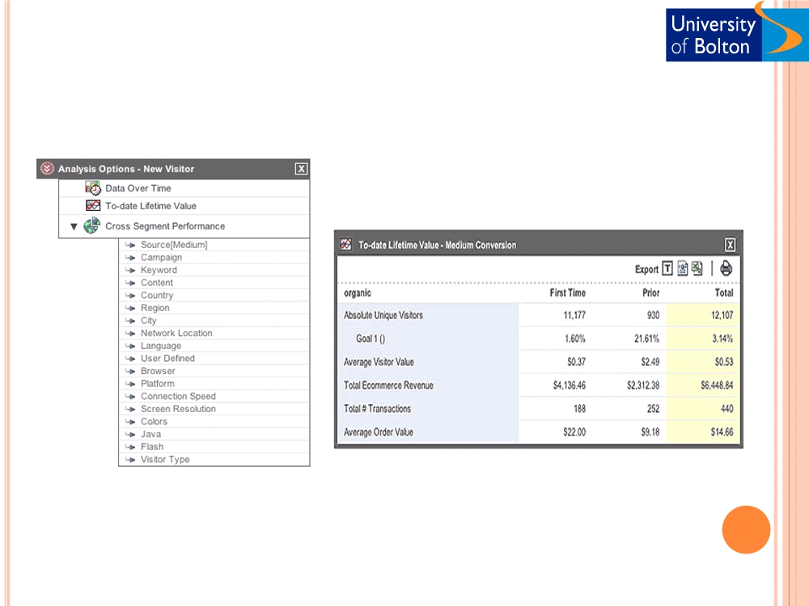
WEB ANALYTICS CON‟T
(Ref. Google Analytics)

Slide 28
Return on Investments (ROI)
○ Before funding an initiative, managers use ROI analysis to determine which projects merit funding.
○ They may revisit ROI at the end of the project to measure actual performance.

Slide 29
STRATEGY IMPLEMENTATION ISSUES
○ Application development
 Choosing an appropriate route for developing applications can be an important challenge during the implementation phase (Internal development/ external vendor/ ASP/ Hosting?)
○ Business partners/ alliances
 Business partner‟s (technology vendors, ASP‟s, etc.) strategies and motivations can also impact the strategy implementation.
○ Customers of Peoplesoft can face problems after Oracle‟s takeover  Paypal and Google turning competitors
 Cooperation at strategic and/or operational levels may be needed to implement certain e-business strategies
○ Development of complex e-business applications  CNN and Yahoo search
○ Cisco and Computer Associates  Yahoo and Reuters
○ Business Process Reengineering
 Implementing an e-business strategy may need
○ Modifying existing processes or
○ Introducing new processes
 Poses challenges such as redesigning the organisational structures, resource allocation, business operations etc.

Slide 30
❑ Activity and discussion
❑ Formulate an e-business strategy (for your organisation or a case) using the following approaches . Enlist various e-business alternatives and determine the best opportunity.
○ BCG growth-share matrix
- Group 1
○ Return on Investment (ROI)
- Group 3
○ GE Multifactor business portfolio matrix
- Group 5
○ Road mapping
- Group 6
❑ Identify complexities/ challenges which may arise in your (or a case) organisation during the e-business strategy implementation phases. Consider various approaches and issues discussed.
❑ Group 2
❑ Identify complexities/ challenges which may arise in your (or a case) organisation during the e-business strategy assessment phase. Consider various approaches and issues discussed.
❑ Group 4
❑ References

Chen, S. (2001) ―Strategic management of e-business‖, John Wiley.

Papazoglou, P.M. and Ribbers, PM.A.(2006) ―e-Business: Organisational and technical foundations‖, John Wiley.

Turban et al (2006) ― Electronic commerce - a managerial perspective‖, Prentice Hall..

Porter, M. (2001) "Strategy and the Internet", Harvard Business Review, March 2001.

Porter, M. (1980) "Competitive Strategy", The Free Press, New York, 1980.

