Slide 1
E-BUSINESS STRATEGY AND MODELS
ONLINE FRAUD
Dr. Collins C. Kachaka BSc, MSc, DBA (Cyber Security), CCNA, CWNA, MCP, PCI DSS, CEH, CHFI, ITIL
Email : collinschi@gmail.com

Slide 2
Define Online Fraud?
Factors Promoting Online Fraud
Differences between Physical Fraud
and Online Fraud
Who Commits Online fraud?
How the Fraud is Committed
Types of Online Fraud
Signs of Fraud in an Organisation
Measures to Curb Online fraud

Slide 3
BACKGROUND
Almost a third of UK businesses, (31%), have been targeted by
fraudsters over the past 18 months, according to recent research
from Graydon UK, the commercial credit referencing agency.
The survey also finds that 22% of firms believe that the problem of commercial fraud is getting worse.
The research reports that the most common type of fraud experienced by UK businesses is that of fraudulent credit applications. These account for nearly half (45%) of fraudulent incidents cited by survey respondents.
The latest figures from the Ministry of Justice show that successful convictions brought against fraudsters in Magistrates' Courts actually fell following the introduction of the Fraud Act in January 2007, from 14,300 in 2007 to 13,200 in 2008. (Credit management,
2010)
In US the typical organisation loses 5-7% of its annual revenues to fraud. (ACFE, 2002-2008)

Slide 4
FRAUD is wrongful or criminal deception intended to result in financial or personal gain.
ONLINE FRAUD is a type of fraud that makes use of Internet for its commission.

Slide 5
An ASSET is any company-owned information, system, data or hardware that has VALUE and is used in the course of business activities.
A THREAT is something that may or may not happen, but has the potential to cause serious damage. Threats can lead to attacks on computer systems, networks and more.
A probability or threat of damage, loss, or any other negative occurrence that is caused by external or internal vulnerabilities on software or hardware.

Slide 6
RIDER ET AL., 2009
Computer misuse act 1990 defines three types of offences:
○ To access without authority a computer materials that is a programme or data.
○ To access without authority a computer system with intend to commit or facilitate the commission of a serious crime .
○ To without authority modify computer material
 A modification is defined to include alteration or erasing any program or data on the computer

2006 review : section 3 covers conduct designed to disrupt and deny
computer related services.
○ New section added (3A) ,it is a criminal offence to have or distribute ‗tools‘ to be used for hacking computer networks.
○ If the defendant is outside UK and the computer is in the UK there would be an offence.
○ Internet fraud are frauds committed by people using any internet service available (email, chat rooms, website, bulletin boards,etc).

Slide 7
WHO COMMITS FRAUD?
Employees
Competitors
Suppliers
Core
business
Professional
Business
criminals
partners
Customers

Slide 8
FRAUD RISK MANAGEMENT STRATEGY
To develop a fraud risk management strategy organisations need to consider previous cases of fraud and draw up a list of the major elements which should be in place to reduce risks of similar events occurring.
The spectacular losses in the late 2000s reveals some common factors :
 The fraud risks were not fully understood
 Poor management supervision
 Un-identified weaknesses in internal controls  Ignorance of red flags and fraud warnings
 Honest and innocent people closed their minds to the possibility of fraud
Effective fraud risk management should consider all of the above factors.

Slide 9
FRAUD RISK MANAGEMENT
Develop
an anti
fraud
culture
Measure fraud
Assess
resistance
fraud risk
Strategy
Manage incidents
Treat fraud risk
Detect fraud risk

Slide 10
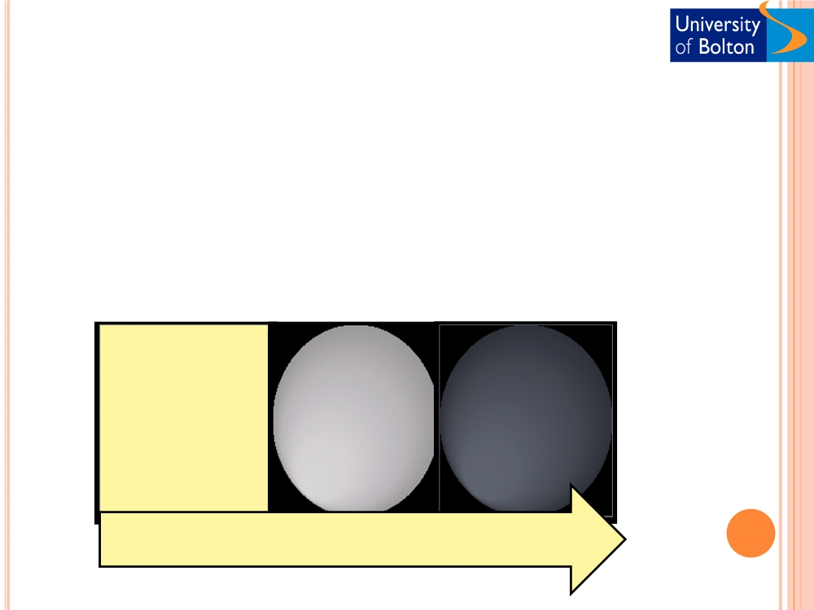
REAL COST OF FRAUD
○ Hidden costs of fraud
○ Cost of investigation  Time
The variable nature of honesty
Genuine expense claim
Claim business class airfare, but fly
Submitting false expense vouchers
economy with spouse
Legitimate business entertaining
Accepting bribes
Gifts from suppliers, customers
Hiring consultants on merit
Submitting bogus consultancy invoices
Hiring family firm without disclosure
Acceptable
Unacceptable
Criminal

Slide 11
THE VARIABLE NATURE OF MOTIVATION
Opportunity
Fraud
Justify
Motivation

Slide 12
DEVELOPING ANTI FRAUD CULTURE
○ The right tone at the top
 Sound in judgment
 Integrity , probity and high ethical standards  Able and willing to inquire and probe  Strength of character
 Strong interpersonal skills
○ Acquiring an understanding of fraud risks  Policy
How an organisation views fraud
 Policy application; where, to whom  Fraud definition
 Stating board‘s attitude toward fraud and offenders
 Provide details on organisation‘s fraud risk management strategy  Fraud prevention and detection responsibilities
 Procedures on the fraud discovery
○ Roles and responsibilities
Potential barriers to developing an anti-fraud culture  Short term incentive schemes
○ Domineering executives
○ Operating in different countries and cultures

Slide 13
TREATING FRAUD RISKS
○ Recording
○ Monitoring  Reporting
○ Fraud awareness training
 Educate employees
 Simulate interest and dialogue around the organisation‘s anti-fraud culture
 Encourage employees to raise their concerns around fraud
 Senior management awareness
 Employee awareness training programme

Slide 14
DETECTING FRAUD
○
Training employees to look for the signs of fraud
 The behavioural signs
○ Overspending
○ Increasing debts and lack of wealth  long absence from work or failure to take leave  Changes to work patterns
○ Long hours after normal business hours  Transactional signs
○ Unusual supplier relationship  Business partners
○ Non-transparent counterparties
○ Vague description of payments for goods and services  Lack of competitive tendering
○ Payments to offshore companies or bank accounts  The system sign
○ Deliberate turning off of audit or controls
○ Using an employees username and password while he/she is on leave  A higher than average number of failed logins
○ Logins at unusual times of the day  The corporate signs
○ No screening and due diligence strategies
○ Autocratic management decisions around business relationships  Losses and declining margins on sales
○ Artificial barriers put up by directors to avoid answering questions  Overriding of budgetary controls
○ Incomplete records  Unusual manual transactions and adjustments

Slide 15
TYPES OF FRAUD DETECTION TEST
Analysis of computer transactions and data
Analysis of indicators related to individuals
Document analysis
Analysis of third parties
Customers , suppliers , business partners , and inspection of premises

Slide 16
MANAGING INCIDENTS
○ Fraud response plan
○ Management responsibilities and awareness of key issues
 Fraud incident management  Senior management
○ Investigation approach
○ Consider whether to, and when to, bring police and media
○ Investigation
 Top management approval  Seeking legal advice  Common objectives  Initial response
 Collecting information
 Conducting interviews
 Preparing for counterattacks

Slide 17
FACTORS PROMOTING ONLINE FRAUD
E-business
 Offer wide variety of products  Have global expansion
 Provide fast and easy access to products and services  Its anonymity attract fraudsters and criminals who try to make quick money
 More than 56% of online shoppers are sceptical of
online shopping mainly because of internet fraud and other security concerns.
Types of internet fraud affecting e-business?

Slide 18
ONLINE FRAUDS IDENTIFIED BY THE INTERNET COMPLAINT CENTRE
○ Auction fraud
 Internet auction fraud could be when you buy fake or stolen goods, or when you pay for goods that never arrive
○ Counterfeit cashier's check
○ Institutional investment fraud
 Institutional investment fraud is when institutions and corporations are targeted to make investments through offers that turn out to be too good to be true includes:
○ Share sale fraud
○ Stockbrokers , usually based overseas, offering shares that premise high returns . ( too good to be true)
○ Pension fund fraud
○ Promise to convert pension into cash before retirement  Ponzi
○ Get rich quick  Pyramid
○ Unsustainable business rewards people for enrolling others into a non-existent business or worthless products
○ Credit card fraud  Scareware
○ Debt elimination
○ Parcel courier email scheme

Slide 19
ONLINE FRAUDS IDENTIFIED BY THE
INTERNET COMPLAINT CENTRE (CON‘T)
○ Employment/business opportunities  Escrow service fraud
○ Identity theft
○ Internet extortion  Investment fraud  Lotteries
○ West African letter fraud or ―419‖  Phishing/ Spoofing
○ Reshipping
○ Spam
○ Third party receiver  Dating fraud
○ Travel and holiday fraud  Charity fraud

Slide 20
HOW TO AVOID ONLINE FRAUD
○ Learn about the sellers and check them properly  Insure products
○ Purchase with credit card to be able to dispute the charges if anything goes wrong
○ Don‘t provide personal information such as NIN, DLN, etc
○ Check out the security/encryption software of the site
○ Don‘t judge a company by its website
○ Obtain physical address of the businesses  Any suggestions??

Slide 21
REFERENCES
Samociuk. M, Iyer. N, Doody. H., 2009, A short guide to fraud risk fraud
resistance and detection, Gover publishing Ltd, England.
Rider. B, Alexander. K, Linklater. L, Bazeley. S, 2009, Market abuse and insider dealing, Tottel publishing, west Sussex.
Anonymous. 2010, ‗UK firms under fraud attack‘, credit management, Stamford. pg. 12, 1 pgs.
http://www.fbi.gov/scams-safety/fraud/internet_fraud/internet_fraud
http://www.bionomicfuel.com/internet-investment-fraud/
http://www.ic3.gov/crimeschemes.aspx
http://www.fraud.org/tips/internet/general.htm

