Slide 1


E-BUSINESS STRATEGY AND MODELS
LECTURE 8
E-marketing, social media marketing
Email : collinschi@gmail.com

Slide 2

E-MARKETING
❑ Marketing for the Web
❑ To use the web as well as traditional channels to develop
❑ a positive and long-term relationship with customers
❑ e-Marketing is Marketing that uses the Internet as
❑ manifestation media (Mark Sceats, 2006)
❑ e-Marketing is the sum of all activities a business conducts
❑ through the Internet with the purpose of finding,
❑ attracting, winning and retaining customers (CISCO 2006).
WWW.ezinearticles.com

Slide 3
E-MARKETING CON‘T
○ E-Marketing
○ Improving online visibility
○ Search Engine visibility
○ Targeting the right customer through appropriate
segmentation
○ Analytical systems and data warehouses
○ Effective website design
○ Search engine Optimisation
○ Visually appealing
○ Appropriate technologies (JSP, ASP, HTML etc)
○ E-Mail Marketing
○ Banner ads
○ Providing the link to other web sites
○ Social Media Marketing

Slide 4
MARKETING AND E-MARKETING
To use the web as well as traditional channels to develop a positive and long-
term relationship with customers .
○ E-commerce opens new channels
○ Marketing theories and practices
○ E-commerce and traditional models of
marketing
○ Marketing is a science
○ How people behaviour in the online
marketing
○ What kind of people go online

Slide 5
ONLINE ACTIVITIES
○ Number of new online users
○ The growth rate of online users
○ Reliance on online growth rate
○ Online activities
○ E-mail
○ Surf for fun
○ Visit an entertainment site
○ Look for information on hobbies
○ Get news

Slide 6

ONLINE ACTIVITIES
Scope
Percentage
❑ E-mail
92
❑ Surf the web for fun
84
❑ Visit an entertainment site
❑ Look for info on hobbies
83
69
❑ Get news
68
❑ Play or download games
❑ Research
66
66
❑ Listen to music online
❑ Visit a chat room
59
55
❑ Check sports scores
❑ Employment
47
26
❑ Games
26
❑ Create a web page
❑ Car search
24
21
www.InternetWorldStats.com

Slide 7
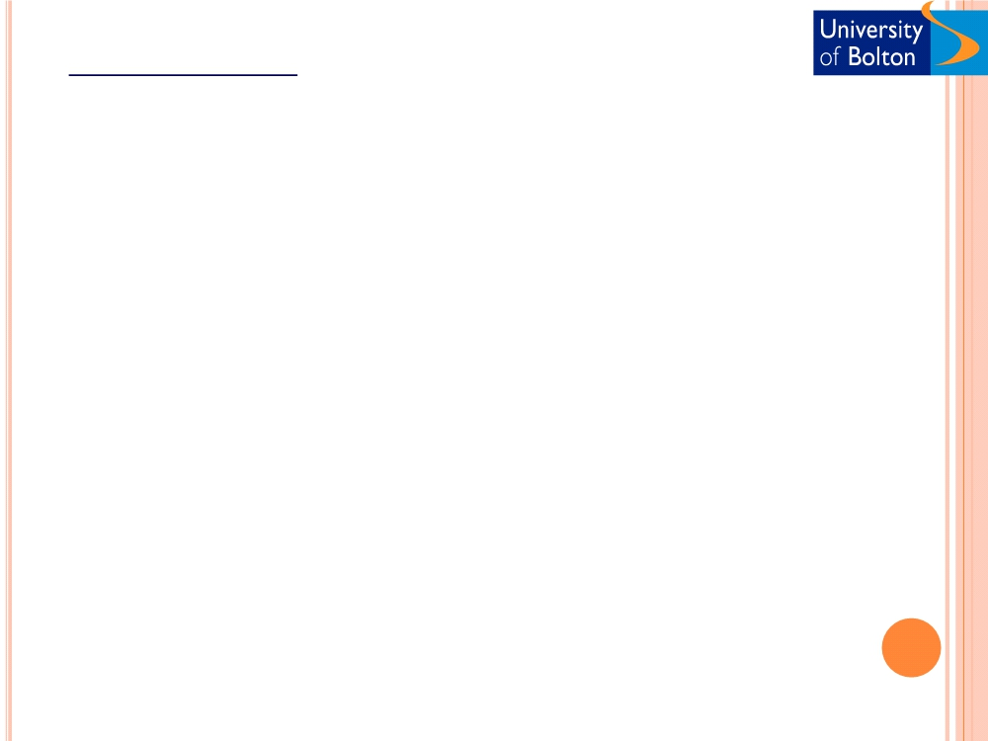
E-MARKETING
ONLINE PROFILES & REPUTATION
The following sites compile estimates from different
industry analysts of e-commerce in different industries
and geographical markets.
❑ InternetWorldStats.com
❑ nua.com
❑ Clickz.com
❑ itu.int
International Telecommunication Union(ITU) presents
data on The Internet and PC penetration in over 200
countries.
www.InternetWorldStats.com

Slide 8
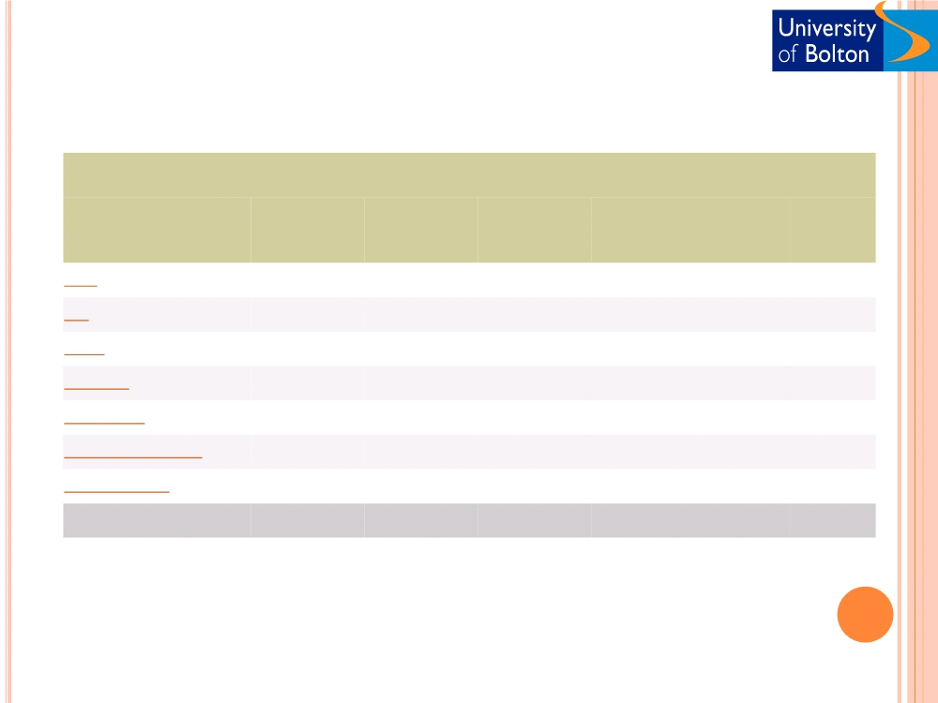
WORLD INTERNET USAGE AND POPULATION STATISTICS
World Regions
Population Internet Users Internet Users
Penetration Growth Users %
( 2010 Est.) Dec. 31, 2000 Latest Data
(% Population) 2000-2010 of Table
Africa
1,013,779,050 4,514,400 110,931,700
10.9 % 2,357.3 % 5.6 %
Asia
3,834,792,852 114,304,000 825,094,396
21.5 % 621.8 % 42.0 %
Europe
813,319,511 105,096,093 475,069,448
58.4 % 352.0 % 24.2 %
Middle East
212,336,924 3,284,800 63,240,946
29.8 % 1,825.3 % 3.2 %
North America
344,124,450 108,096,800 266,224,500
77.4 % 146.3 % 13.5 %
Latin America/Caribbean
592,556,972 18,068,919 204,689,836
34.5 % 1,032.8 % 10.4 %
Oceania / Australia
34,700,201 7,620,480 21,263,990
61.3 % 179.0 % 1.1 %
WORLD TOTAL
6,845,609,960 360,985,492 1,966,514,816
28.7 % 444.8 % 100.0 %
www.InternetWorldStats.com

Slide 9
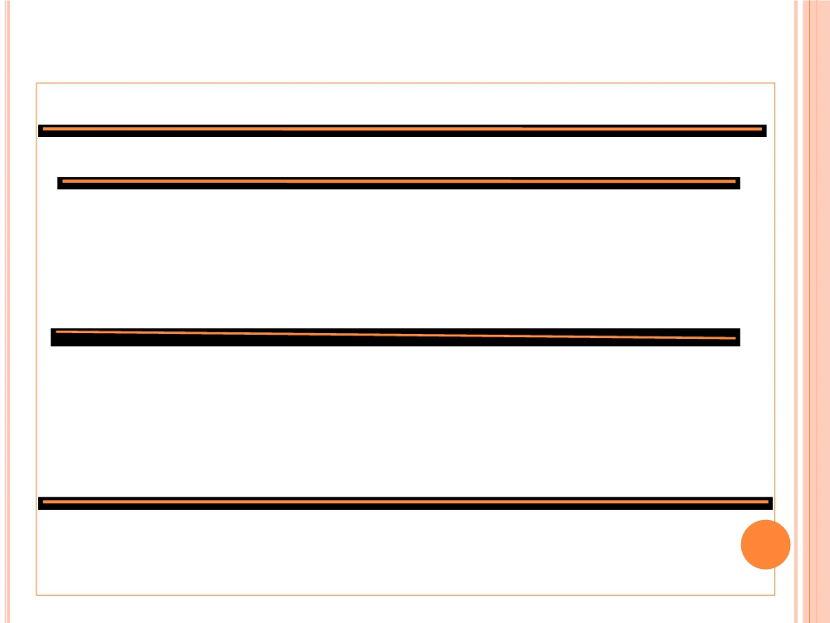
When adults last used the Internet, by sex and age group, 2008 to
2010
Within the last 3 months
More than 3 months
Never used
2008
2009
2010
2008
2009
2010
2008
2009
2010
Per cent
Men
75
80
79
4
3
5
20
17
16
Women
66
72
75
5
4
4
29
24
21
All
71
76
77
5
4
4
25
21
18
16-24
93
96
97
5
3
2
1
3
1
25-44
87
92
93
5
3
3
8
5
4
45-54
78
81
84
4
3
4
17
16
11
55-64
63
72
72
4
4
6
33
24
22
65+
26
30
32
5
5
7
70
64
60
Base: UK adults

Slide 10
CUSTOMER BEHAVIOUR MODELS
❑ Who is online
❑ How consumer behave online
❑ Social science, sociology, psychology, & economics
❑ To model and understand human behaviour in
❑ a marketplace
❑ Models predict/explain what customer purchase
❑ Where, when, how much, why they buy
❑ To understand customer decision-making process

Slide 11
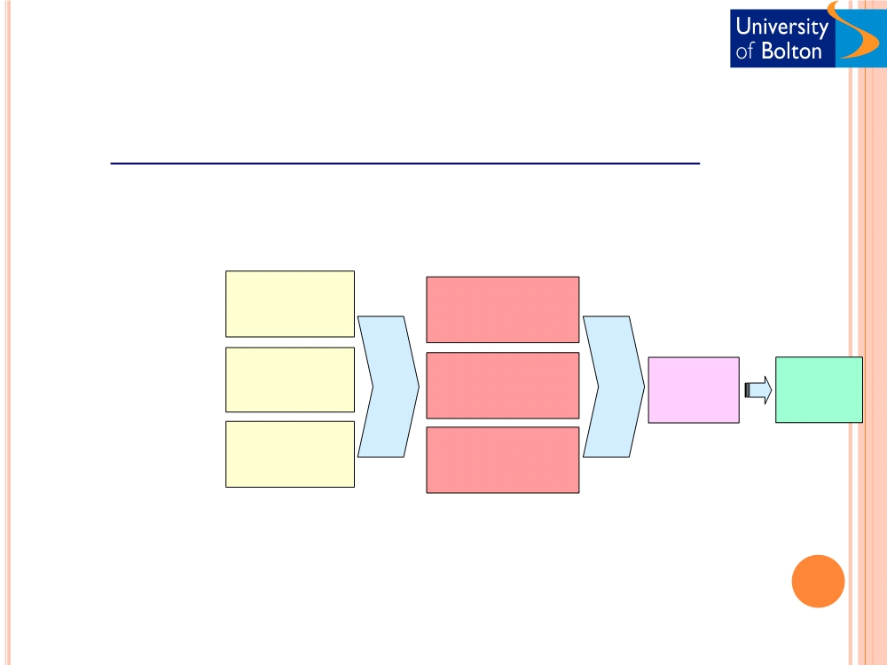
Consumer Behaviour Model (offline)
Consumer‘s ultimate decision on the basis of a wide range factors
❑ Values
❑ Wants
❑ Perception
❑ Behaviour
❑ Sub-culture
Cultural
Brand
Marketing
Social
communication
stimuli
In-store
behaviour
Buyer
❑ Consumer
❑ behaviour
❑ Reference
❑ groups
decisions
Psychological
Firm
capabilities
Demographic
variables
Intervening
Dependent
variables
❑ Opinion Leaders
variables
❑ Needs
❑ Drives
❑ Learned behaviour

Slide 12
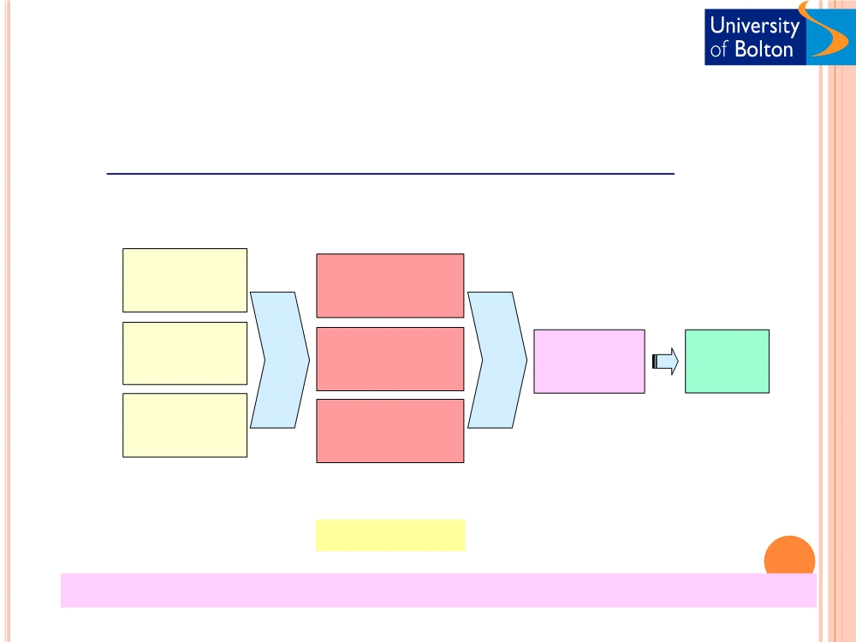
Consumer Behaviour Model (online)
Cultural
Brand
Marketing
Social
communication
stimuli
Clickstream Buyer
behaviour decisions
Psychological
Firm
capabilities
Demographic
variables
Intervening
variables
Internet Dependent
behaviour variables
Web site features
variables
Clickstream - The transaction log that consumer establish as they move about the
web

Slide 13
CUSTOMER BEHAVIOUR MODELS
❑ Influence of store design on consumer behaviour
❑ Understanding the precise consumer movement
❑ Store design (High margin items on the right)
❑ Store design (Fresh Dairy products at the back)
❑ WalMart and consumer tracking databases
❑ Technical implementation, lowered cost, and its
❑ comprehensiveness

Slide 14
CLICKSTREAM BEHAVIOUR
The transaction log that consumer establish as they move about the web.
❑ Impact of background demographics of Internet users
❑ 10% of observed behaviour
❑ Important predictors of online consumer behaviour
❑ sessions characteristics and clickstream behaviour
❑ To understand consumer needs at each moment
❑ How much they are willing to pay
❑ Precise targeting communication

Slide 15
PURCHASING DECISION - OFFLINE
❑ Awareness, need recognition Mass media
❑ Search
catalogue, add,
sales rep, store visit
❑ Evaluation of alternatives Ref group, mass media,
store visit
❑ Purchase
Promotion, direct mail
❑ Post-purchase behaviour Warranties, service call,
parts and repairs

Slide 16
PURCHASING DECISION - ONLINE
❑ Awareness, need recognition
Banner adds
❑ Search
Search engines, t-email,
catalogue, site visit
❑ Evaluation of alternatives SE, catalogue, site visit,
product review
❑ Purchase
On-line, t-email
❑ Post-purchase behaviour
e-mail, updates,
newsletters
e-Marketing is the sum of all activities a business conducts through the Internet
with the purpose of finding, attracting, winning and retaining customers.

Slide 17

Shoppers; Browsers and Buyers
❑ Complexity of online behaviour
❑ Clickstream analysis
Books 50
Music 43
Accessories 38
❑ Buyers 40%
Software 29
❑ Browsers 40%
❑ Non-shoppers 20%
Toys 27
Videos 24
Travel 23
Small percentage using banners
❑ Company site 85%
Event thicket 25
❑ Specific products 80%
❑ Goal oriented shopping
❑ Experiential shopping

Slide 18

Shoppers; Browsers and Buyers
Driving qualified traffic
❑ Strategic link development
❑ Search engine optimisation
❑ Article writing help and submission
❑ Newsgroup and forum building
❑ Newsletter development
❑ E-mail marketing
❑ Banner creation and placement
❑ Flash movie development
❑ Site traffic analysis and reporting
www.oakwebworks.com

Slide 19
TYPES OF E-MARKETING
Web Marketing
E-mail Marketing
Social Media Marketing
Search Engine Marketing
Electronic BillBoard Marketing
M-Marketing (SMS )

Slide 20

E-Marketing Strategy & Functions
e-Marketing should ACHIEVE the Objectives below. These constitute
e-Marketing Strategy
Personalisation
Choice of e-marketing and Why?
How the E-marketing will be carried out
Target for the e-marketing and Why ?
Privacy Matters
Customer Service (All Relevant Info)
❑ Community Building
Who will be in charge of E-marketing? Process & technical ?
❑ Site Flair
❑ Customer Security issues
Sales Promotion
How the E-marketing will be evaluated

Slide 21
○ Web 2.0
 A term used to portray the range of technologies that will
enable users to network with each other and create information
instead of just downloading information from the Internet.
○ Social Media
 Social Media is an internet tool for sharing information and
hosting discussion forums amongst the online community.
 Group of new kinds of online media, which encourages
contributions and feedback from everyone interested, and blurs
the line between publisher and audience.
 It‘s a two-way conversation, different from traditional media
which is all about broadcasting.
 Allows communities to form quickly, communicate effectively,
share content and personal opinions and swap different
perspectives about world issues.

Slide 22
WHY PEOPLE VISIT SOCIAL NETWORKING
WEBSITES
○ Keep in touch with friends and relatives
○ Find old friends and relatives
○ To share and store pictures and videos
○ To make new friends
○ To play basic games like puzzles and scrabble
○ To listen to music / watch videos
○ To keep up with current trends

Slide 23
CURRENT TRENDS IN SOCIAL NETWORKING
○ Facebook continues to enjoy rapid growth For e.g. it had
540 million unique users in May 2010.
○ Bebo and MySpace have continued to decline, although
specialist sites such as Twitter and LinkedInhave
displayed strong growth rates over the last few years.
○ Women are more likely than men to be frequent visitors,
as well as spending more time in total on social networks
each month, according to comScore data.
○ Research also shows that social networks appeal to a
wide range of age groups, from children aged 6 to adults
over 55 years of age.
○ Social media tools are becoming mobile friendly enabling
users to access through phones

Slide 24
WHY SHOULD A BUSINESS CONSIDER
SOCIAL MEDIA
○ Widespread usage of social media tools For e.g. Facebook
is the most visited web site after Google costs less
compared to traditional marketing tools.
○ Less spamming - E.g. if someone watches a video, they do
it by choice hence more effective.
○ More chances of becoming viral and hence better
awareness E.g.Blendtec.
○ Good quality information about users and their habits can
help them to reinforce loyalty by listening carefully to
what the users say

Slide 25
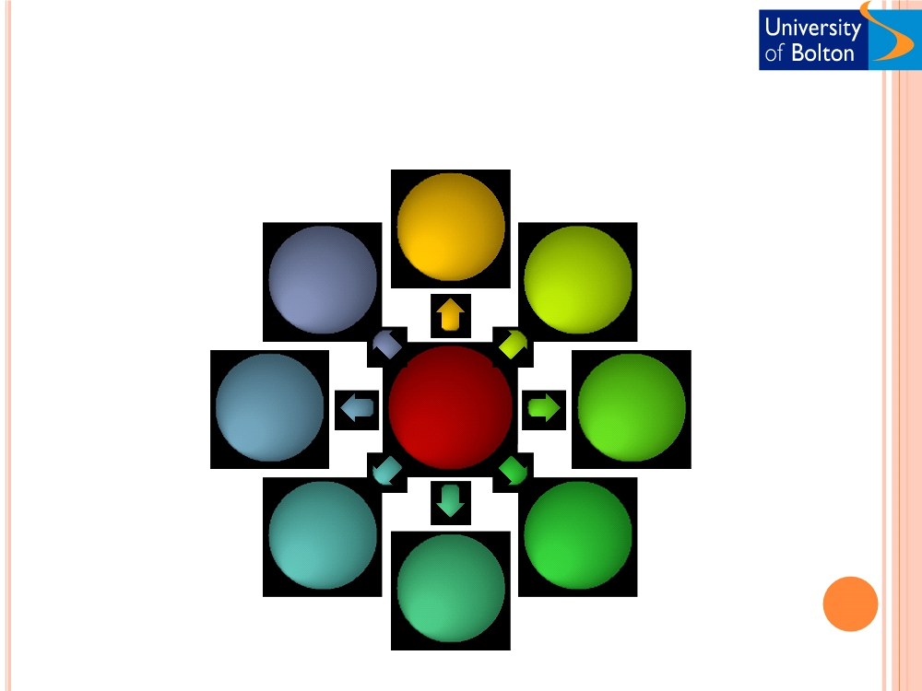
VARIOUS TYPES OF SOCIAL MEDIA
Social
networking
Blogs
Wiki
Social
Media
Video sharing
Social
bookmarking
Play games
Business
networking
Photo sharing

Slide 26
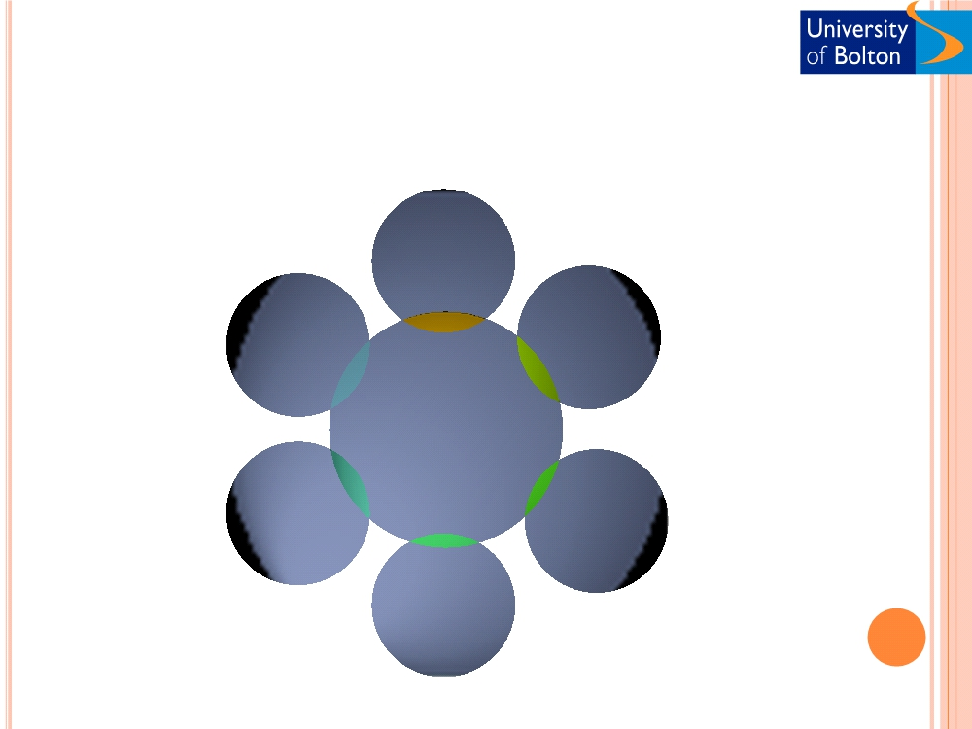
COMMONLY USED SOCIAL MEDIA TOOLS
Twiter
Second
life
Facebook
Social
media
Blogs,
forums,
and book
marking
tools
Youtube
linkedin

Slide 27
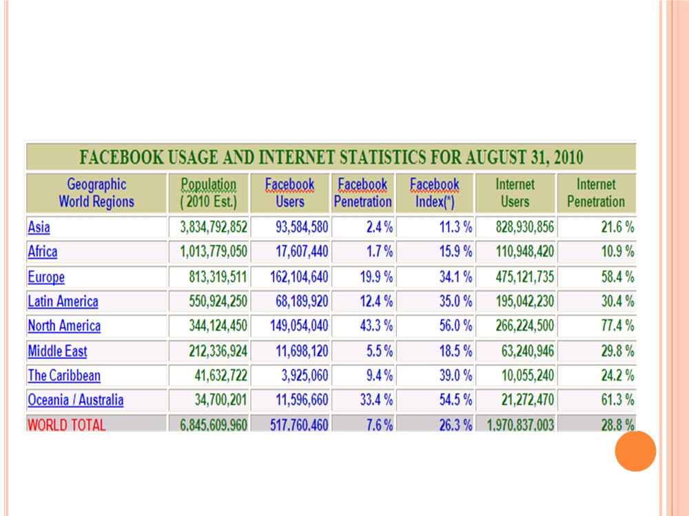

Slide 28
WHAT CAN A BUSINESS DO WITH THESE
TOOLS
○ Identify themselves
○ Enable the online community to associate with
the business
○ Offer help / share knowledge with web users
Personally meet
○ the community
○ Develop games / tools that will create awareness
and popularity
○ amongst users
○ Create virtual environment that will enable
users to create
○ avatars

Slide 29
HOW CAN THEY DO?
○ Main objective should be to build relationships
rather than bombard with messages
○ Innovation is essential for achieving success
through social networks
○ Develop good content that can be shared via blogs
(Current, Truth,comprehensive)
○ Regular update with new content is essential For
e.g. two or three tweets a day
○ Social media tools should be used for ‗social
purpose‘ hence it should be informal, but
professional.

Slide 30
SOME SUCCESS STORIES
○ Barrack Obama became the President of the United
States helped by the extensive usage of social media
tools and blogs. His website
www.mybarrackobama.com alone generated US $ 80
Million of revenue.
○ Dell generated $3M revenue through twitter by
directly interacting with its customers.
○ IT Toolbox have grown their social network for IT
professionals into multi million dollar business with
more than $8 Million in ad sales, and 1.7 million
pages of user generated content as of Jan. 1, 2008

Slide 31
SOME SUCCESS STORIES CON‘T
○ Butler sheet metal - a small family owned specialist sheet
metal fabricator based in Lancashire run the award winning
Tinbasher blog, one of the UK's most prominent business
blogs, and required a hosting company that could handle their
existing blog traffic as well as offering them further scope for
growth. This had a positive impact on search engine rankings
(Ranked number one in google search results).
○ Namecheap - a small company that sells domain names
organised contests using Twitter during the Christmas period.
The winner was provided with a one year free domain name
from Namecheap. The outcome - ―Namecheap's site traffic
increased more than 10 percent in December, driving a 20
percent increase in domain registrations‖

Slide 32
THE WAY FORWARD
○ Social Media Marketing is becoming a popular tool.
○ Internet is poised to become 3D soon with second life
as an example.
○ Social media coupled with 3D technologies will be the
next hype.
○ New positions such social media branding specialist
will not be uncommon.
○ With the advent of mobile applications, business will
continue to increase the usage of social media
marketing tactics.
○ Organisations have started to incorporate the
features of social media tools within CRM
applications and corporate communications.

Slide 33
ACTIVITY
○ Visiting the allocated e-commerce site, what
actions could be taken to increase the likelihood
that shoppers and non-shoppers would purchase
on-line.

