Slide 1
VALUE CHAIN ANALYSIS
&
PORTER’S FIVE FORCES

Slide 2
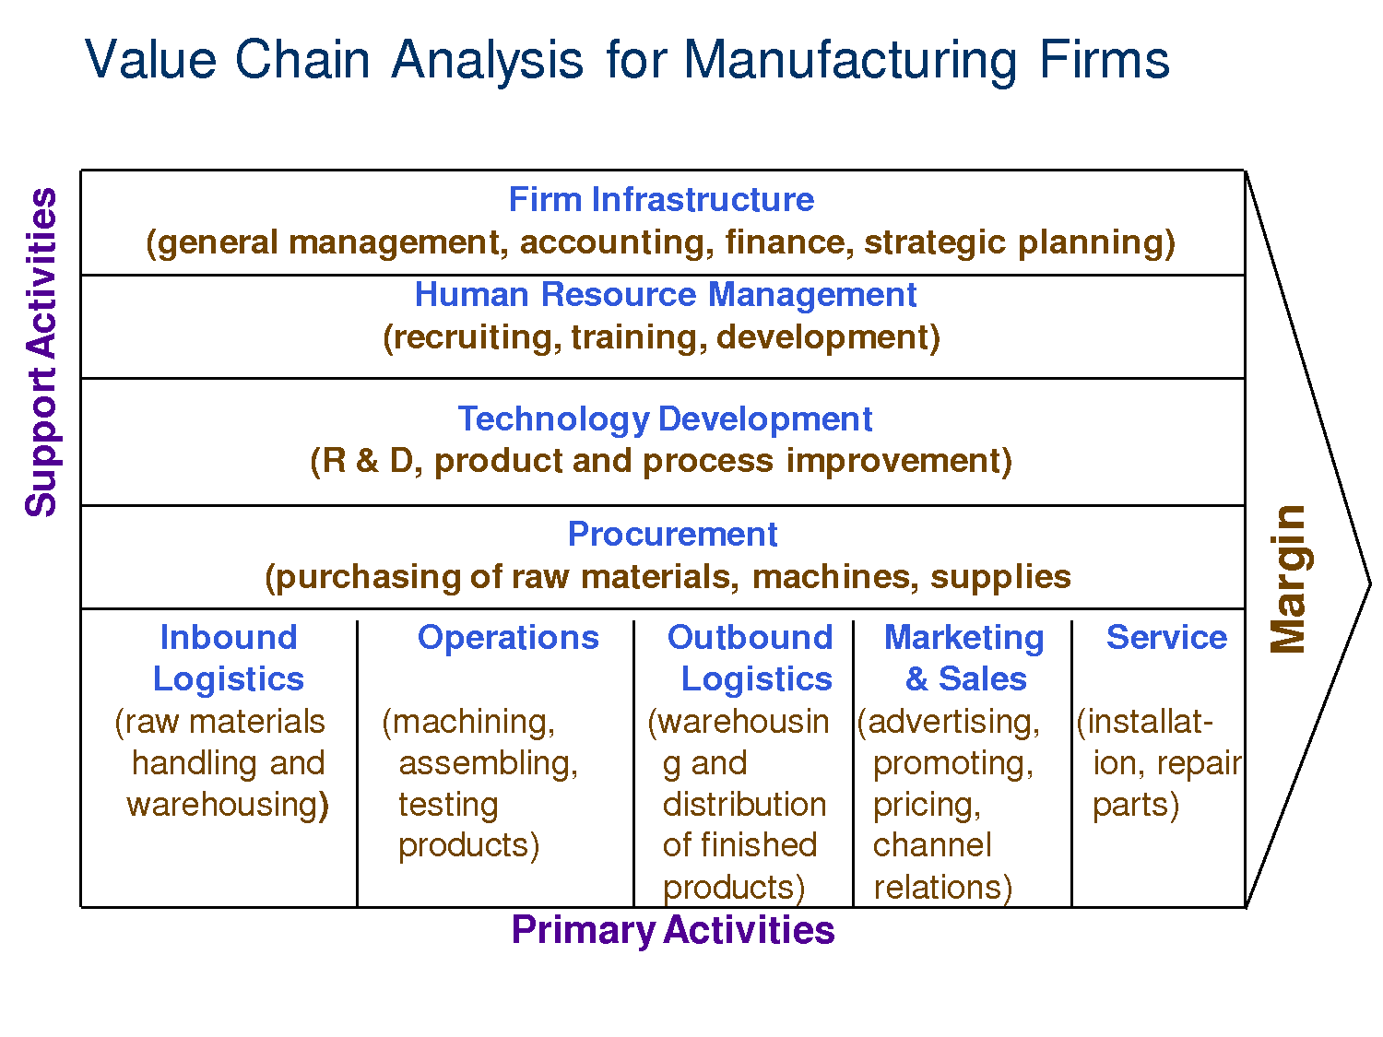
The Value Chain

Slide 3
Value Chain (contd.)
Inbound Logistics: raw materials brought into the company
Operations: any part of the business that converts raw materials into products and services
Outbound Logistics: Getting the products
and services to the customers.

Slide 4
Value Chain (contd.)
Sales/Marketing: Entire buyers to purchase products and services.
Service: Support of products and services that customers have purchased.
Firm Infrastructure: All the organizational functions that support the business.
Technology connected/supported.
Human Resources Management: Recruiting
hiring, and retaining employees.

Slide 5
Value Chain (contd.)
Technology Development: Advances and innovations adopted to add value to the company.
Procurement: Acquiring raw materials for production/operations.

Slide 6
The Value Chain Model & CRM
Enterprise Resources Planning
Supply Chain Management
Customer Relationship Management
Graphic from Docstock.com
Notes:
This is a mini-lecture. But, the ideas are powerful. Again Michael Porter came up with a way to describe organizations by their strategic focus in the firm.

Slide 7
Porter’s 5 Force Model
Government
Regulation
Threat of
New Entrants
Bargaining Power of Suppliers
Industry
Rivalry
Bargaining Power of
Buyers
Threat of
Substitute Products
Notes:
This is Porter’s model of competitive strategy.
At the center of the model is Intra-industry rivalry or competition within the industry.
How competitive is the market? Think about MikeyD’s (McDonalds). How many other fast food chains are in the market competing with you. Burger King, In&Out, Wendy’s, EZOut Burger, Some smaller chains, …Plenty. It is a very competitive marketplace and you have to distinguish yourself with high quality, low cost or service. With Mickey D’s they offer very quick service at a reasonable price. It is great for food on the go and great with the kiddies getting the happy meal.
The next competitive force is the Threat of New Entrants. How many companies are seeking to break into the fast food, chain industry? I doesn’t happen. Not many because the cost to compete with these fast food giants is very prohibitive to competing in that market.
The third competitive force is the ‘Threat of Substitute Products’. This means other places your customers might go to get what you offer. So, Panera Bread, Taco Bell, a Pizza place or a regular restaurant would all be substitute products to what MickeyD’s offers. Companies need to consider these competitors too so they can think about competitive pricing and features that make people select fast food over other types of eateries.
The 4th for is the “Bargaining Power of Buyers”. In the case of Mickey D’s, that is you and me. We have a choice of what we eat and there are plenty of other fast food restaurants we could go to. So, our bargaining power is very high. If the line is too long at MickyD’s or DerWeinerschnitzel is giving away free sauerkraut dogs, we can drive across the street and eat there.
The 5th force is “Bargaining Power of Suppliers”. That is the companies supporting the products and services that lead to you getting a Big Mac. Someone sells beef, soda, bread, coffee, uniforms, cleaning supplies, health care…etc. to make the McDonalds organization run. If the companies that sell beef are scarce, like only two companies you can buy beef from, then the supplier power is high. They can raise their price and McDonalds has to pay because they cannot operate without it.
On the other hand, if the uniform manufacturer decides to increase costs, there are a lot of companies that sell uniforms. McDonalds can switch suppliers without losing a lot of business. So, in that case the bargaining power is very low.
Go it?
6th competitive Force – Government
Let’s take an example, then you do one. This model is really for understanding the competitive forces that operate in an industry before you develop your own strategy for your company.

Slide 8
5 Forces
Bargaining Power of Buyers (customers): Ability of the customers to put the firm under pressure to reduce prices.
Bargaining Power of Suppliers: Power of suppliers to control prices.
Intra-Industry Rivalry: Competitiveness of a given industry. Threat of New Entrants: Profitable industries attract new competitors. (Amazon producing TV shows)
Threat of substitute products and services:
Other entities that consumers can use,
instead of your product. (bike instead of car)

Slide 9
Entry Barriers
Creating a barrier to entry to would be competitors.
Southern California Edison
  Utility, captive market
  To open an electric company would require a massive infrastructure
Bar
  Liquor license is a cost that might prohibit entrants
Online mega-store like Amazon
  New entrants cannot compete with branding, infrastructure and supply chain
Notes:
Another way the 5 force model is used is in thinking about stregegy. Knowing that our company may operate in an industry with low entry barriers, how can we make it harder for new entrants to come into the market? How can we reduce the force of ‘Threat of new entrants?’.
To do this, we need to think about adding cost, legislative or quality barriers that new entrants would have no chance of duplicating
Think of So. Cal Edison
Edison. Only one, not competition. Though solar and wind might be, still integrated into Edison.
Bar. You need a liquor license.
Online mega store to compete with Amazon.

Slide 10
Switching Costs
Switching Cost – The cost of a customer to switch to another product or service.
Used to reduce the threat of new entrants and substitute products.
Increasing Switching Costs
  Deals for Staying with You (loyalty programs)
  Memberships
  Contracts
Notes:
Switching Costs
Increasing Switching costs is a way to prevent your customers from going to substitute products. To achieve this, you can offer them deals and memberships or you can have them sign contract agreements so they are stuck with you for an agreed upon period of time.
Being a member of a frequent flyer program (like southwest) means that I’ll earn free miles and rewards every time I fly with them. So, when buying a ticket for a trip, I always go to them first.

Slide 11
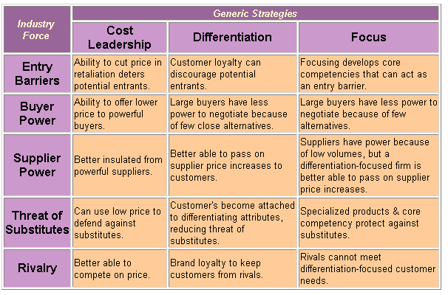
Strategies and Forces

Slide 12
Using Information Systems for Competitive Advantage
Business Process Management Systems
  Control of processes gives competitive advantage because ___.
Electronic Data Interchange
  Automation of the value chain gets products to market quicker.
  Allows for integration of partners in the value chain.
  Allows for flexible value chain because of automation.

Slide 13
Competitive Advantage (contd.)
Collaborative Systems – Easier ways for people to collaborate in work and processes.
  Google Drive
  MS SharePoint
  Cisco WebEx
  Atlassian Confluence
  IBM Lotus Notes

Slide 14
Competitive Advantage (contd.)
Decision Support Systems
  Assist with decision making at all levels, particularly semi-structured.
  Data Analytics
  Internally: Having centralized data can give opportunities to see what the data is telling you.
  Externally: Data sources can inform
  strategic decisions about new technologies
  and your industry.

Slide 15

Summary
Defined the productivity paradox.
Evaluated Carr’s argument in “Does IT Matter?”
Reviewed the components of competitive advantage.
Reviewed how information systems that can provide businesses with competitive advantage.

